Slide 1

Chris Haynes
Student Program Coordinator
Spain
Lia Fleming
GloBull Ambassador President
Italy
Tanisha Pierrette
GloBull Ambassador/Diversity Series
Costa Rica
FICE Conference, 2015
Education Abroad Student Ambassador Programs

Slide 2





Workshop Agenda
A look at Education Abroad at USF- Chris Haynes
Programs
Trends
University & Education Abroad Office goals
Resources
For Students by Students
Lia Fleming
Lia’s Story
Program Development
Student Roles
Program Goals & Objectives – Student Driven
A closer look at Study Abroad Ambassador Programs- All
What our program looks like
Effective training strategies
Program commitment
GBA goals vs Education Abroad Office goals
Open Discussion
Student Led Programming- Tanisha Pierrette
Tanisha’s Story
What makes student led programming successful
Black & Abroad from start to finish and beyond

Slide 3
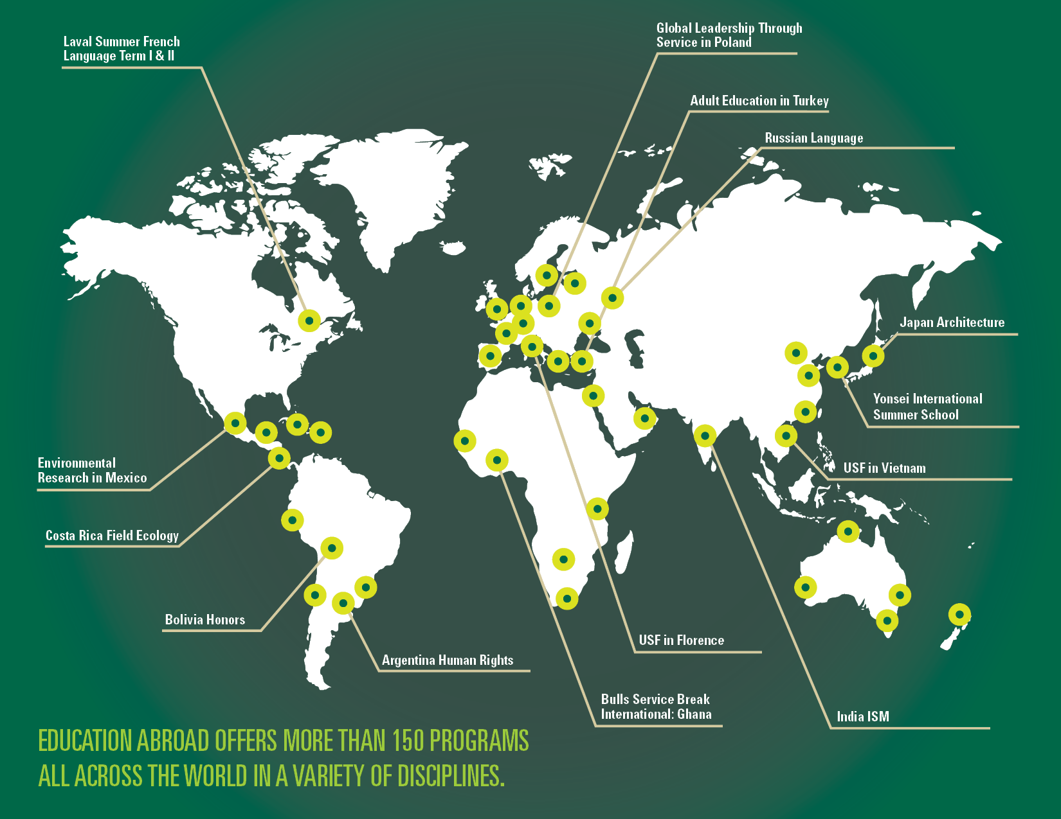

Slide 4
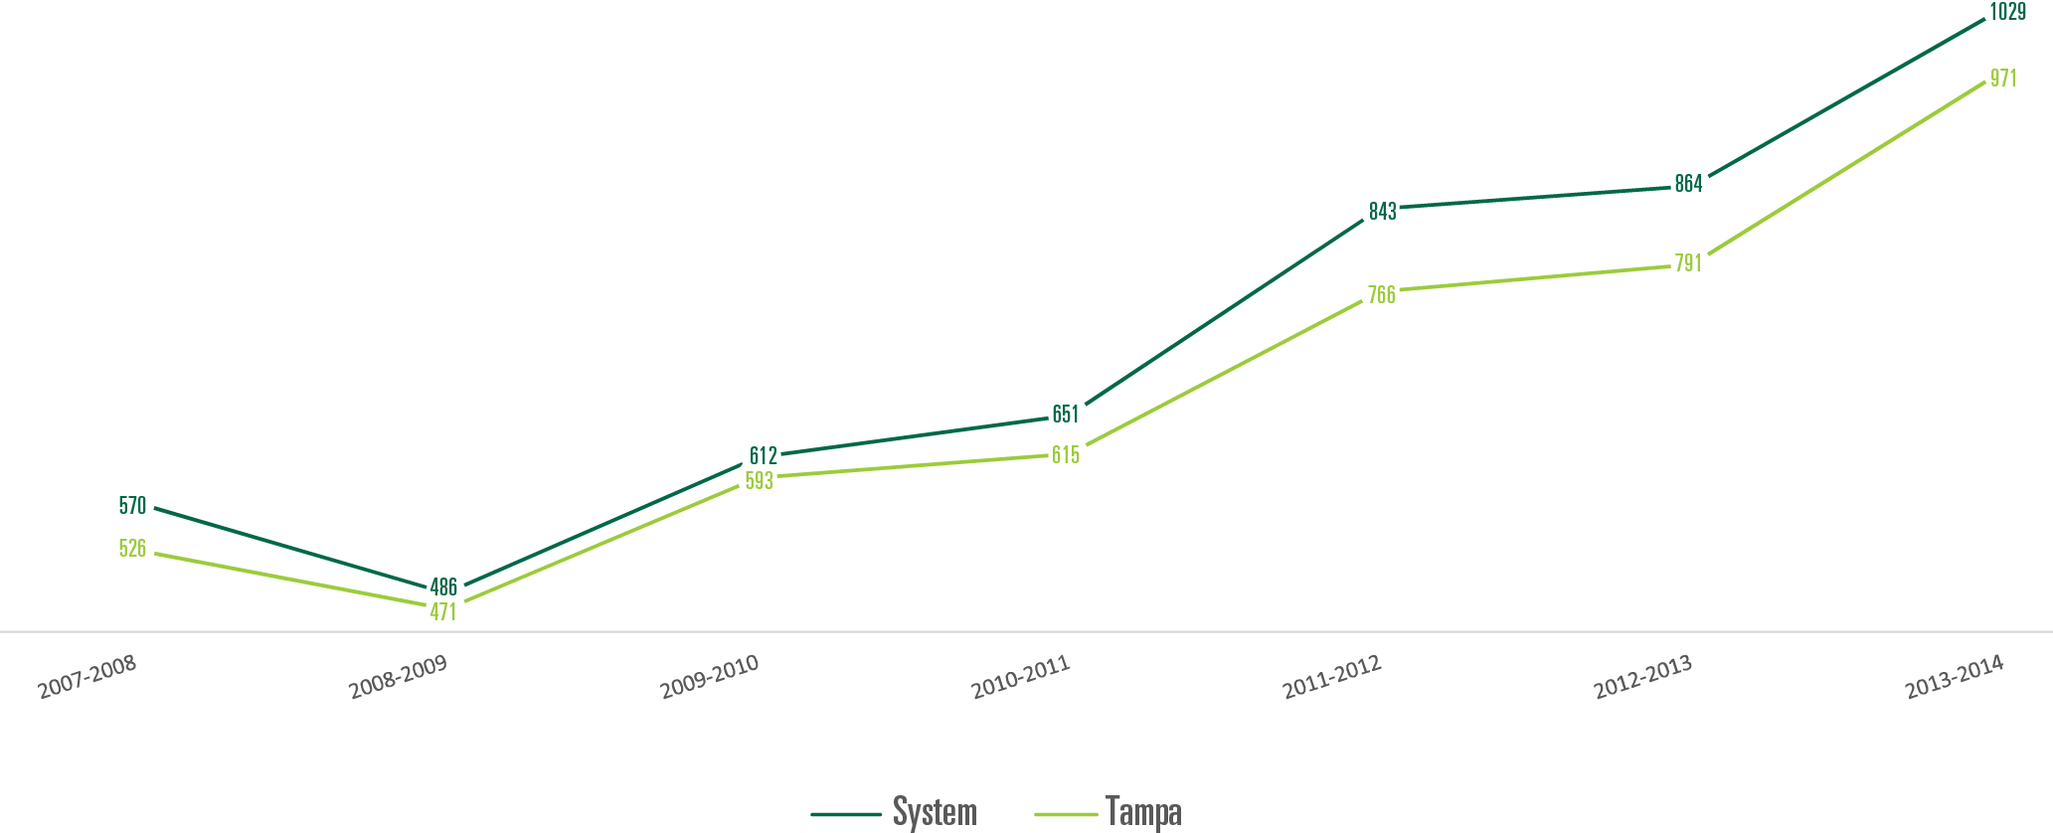
STRATEGIC PLAN METRICS
Undergraduate Trends at USF

Slide 5
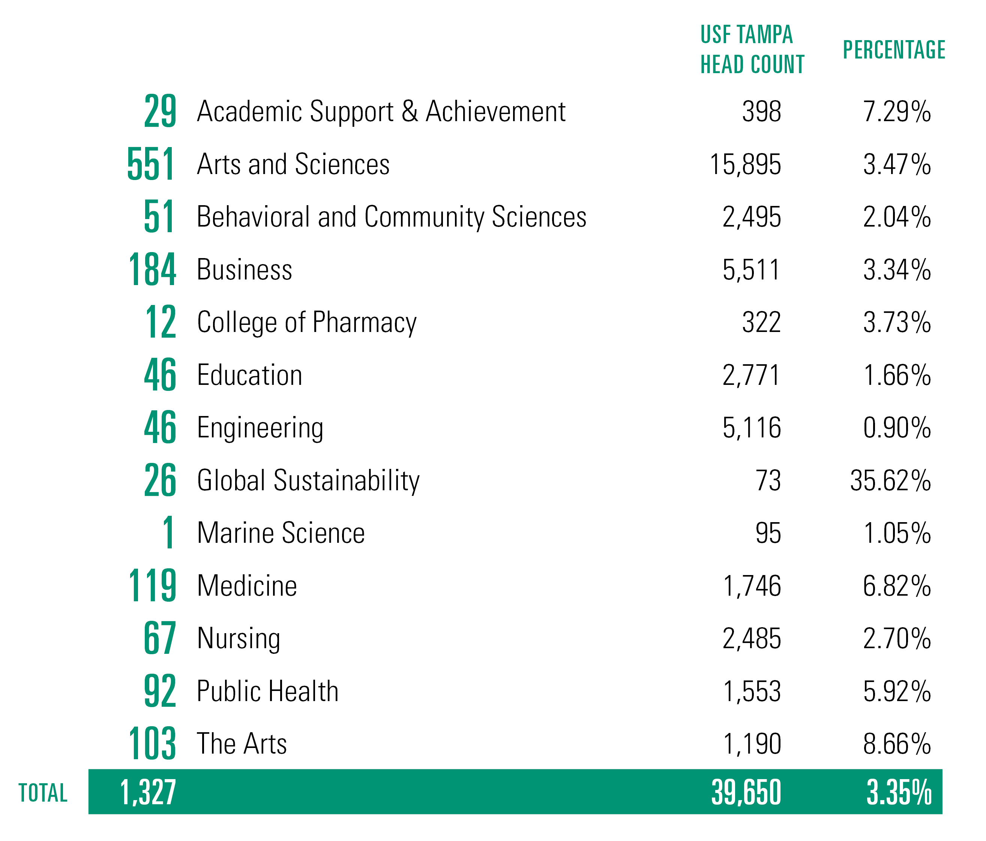
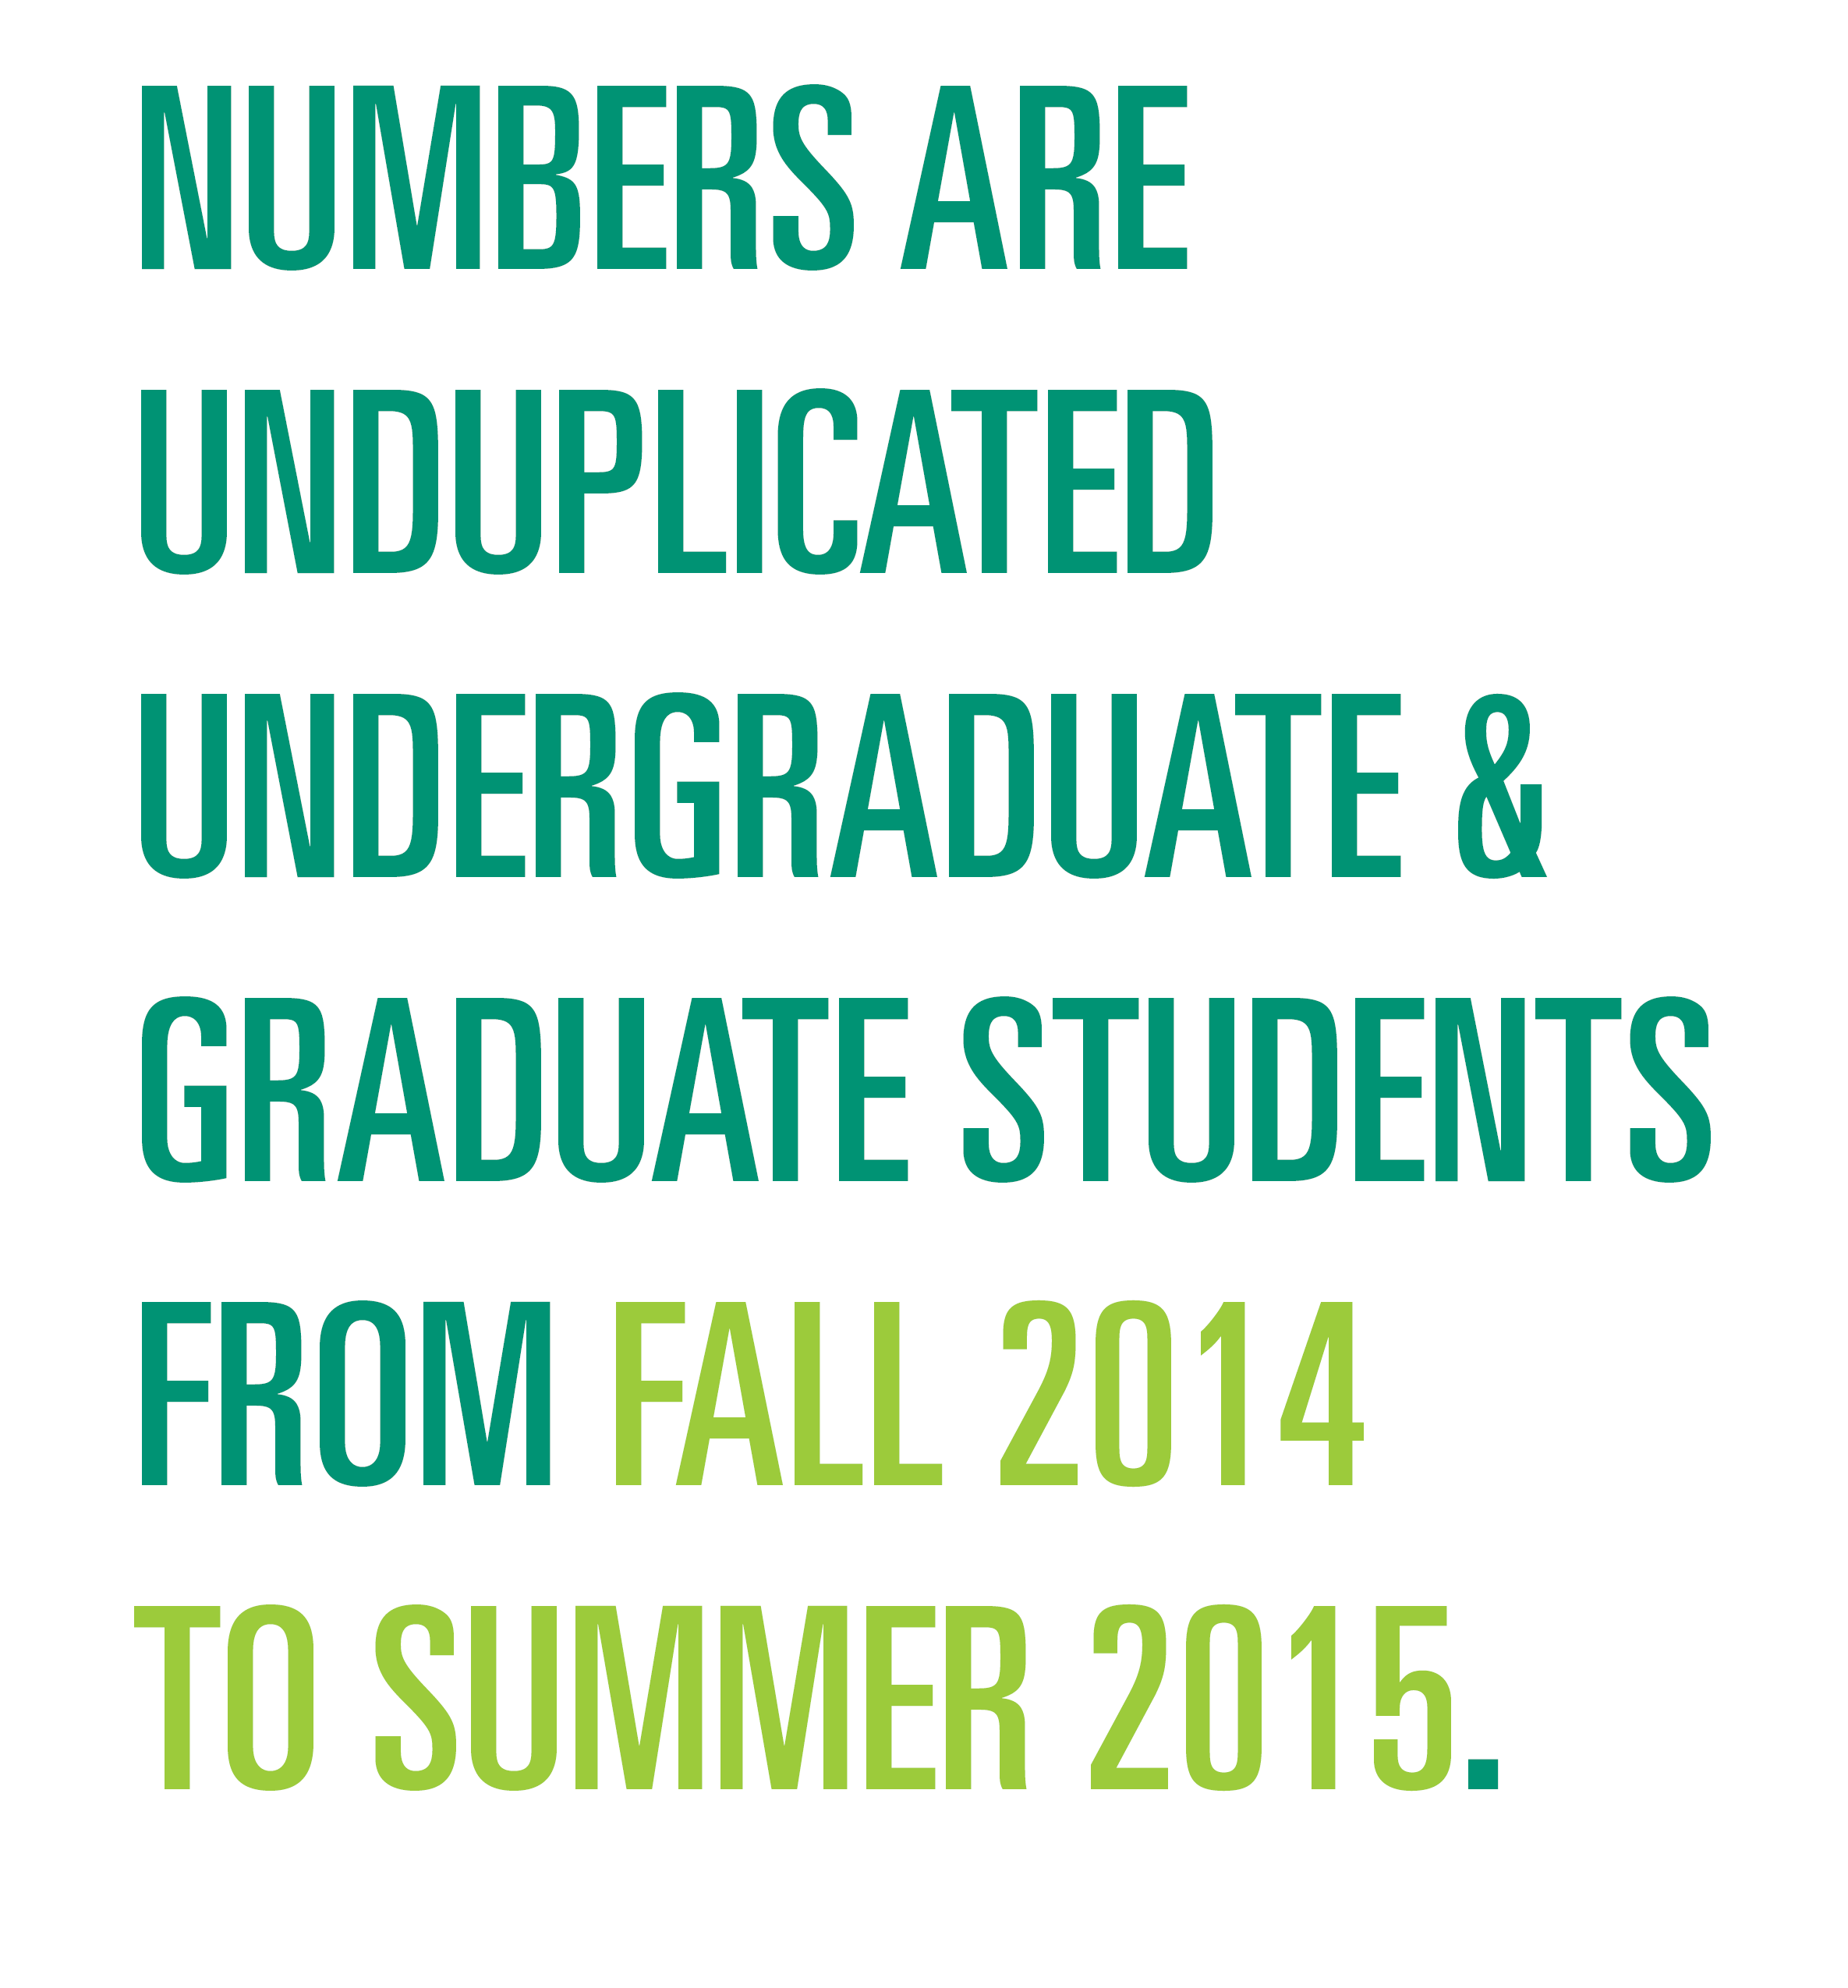
USF TAMPA STUDY ABROAD PARTICIPATION BY COLLEGE (PRELIMINARY)

Slide 6
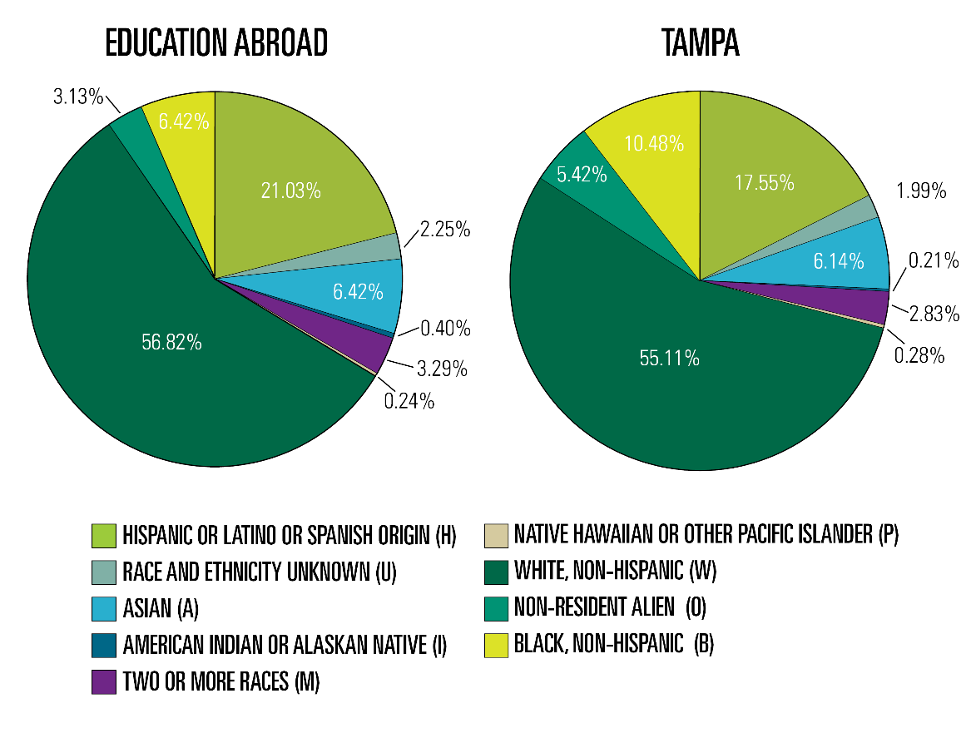
DIVERSITY COMPARISON

Slide 7
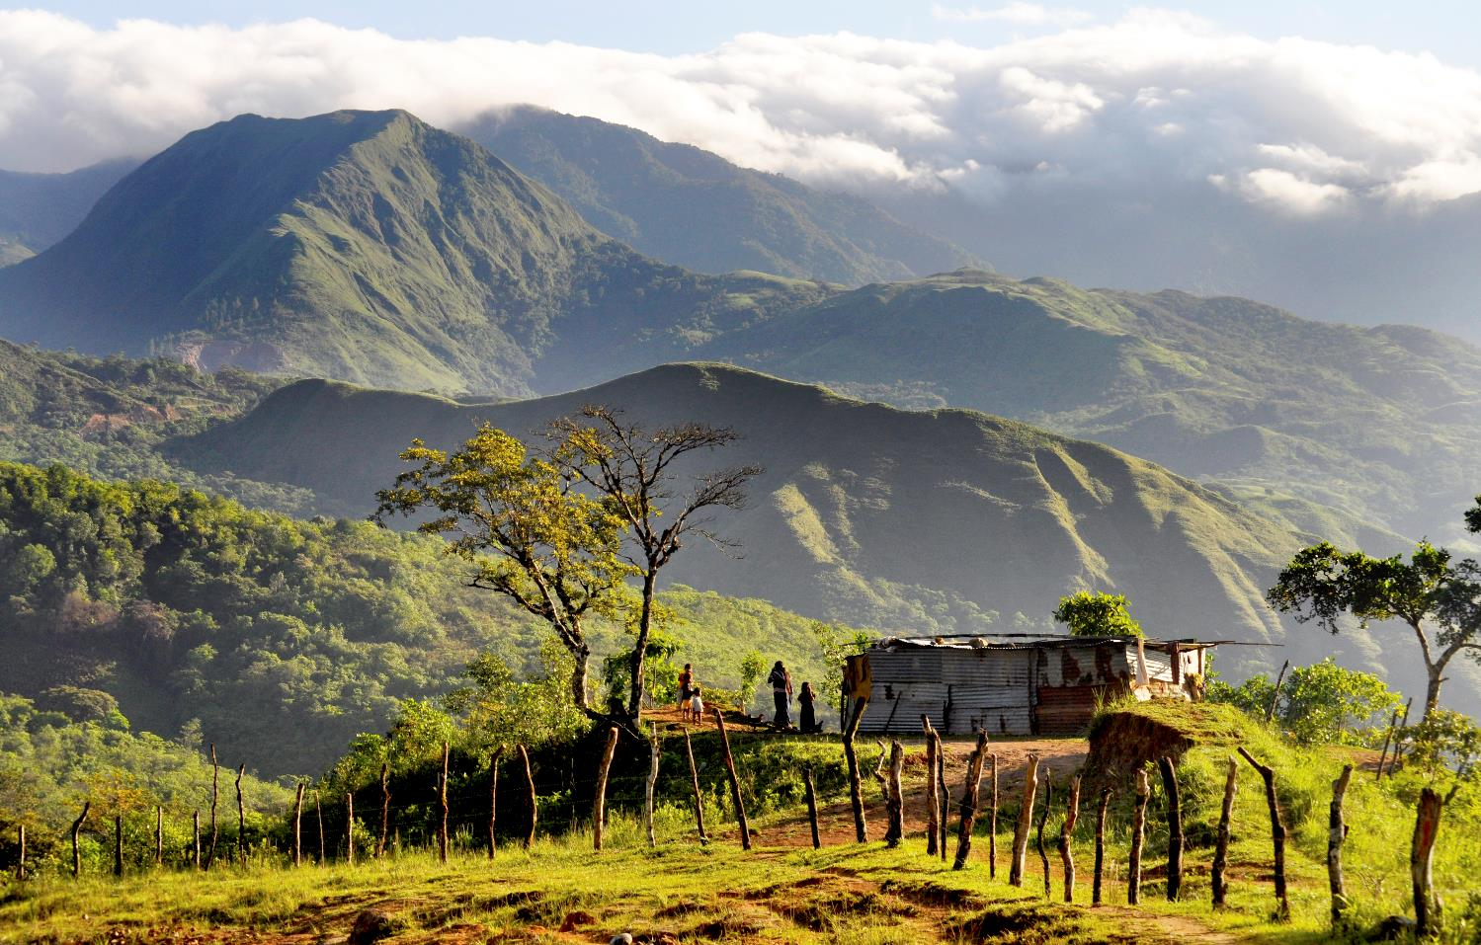
USF Education Abroad GloBull Ambassador Program
Discussion Topics to keep in mind:
Main Ideas:
Student led initiatives and programming
Strategies to combine re-entry & outreach efforts
Variety of functions that this program can have
Areas of consideration:
  Effective training practices
  Student commitment
  Connection with students
  Focus on sustainability compared to new programming
Notes:
As we go over some of the basic components and structure of our GBA program at USF I would like you all to keep a few things in mind for our discussion at the end of the workshop. I think this will benefit us all and will help us come up with new ways to improve student ambassador programs.

Slide 8
GloBull Ambassador Overview
GBA’s at a glance
Apply Online
Only requirement is study abroad experience
10 hours of service/semester
Participate in two of the following
An Education Abroad Fair or Showcase
Represent Education Abroad at Bull Market
Classroom Presentation or Program Information Session
Participate in Pre-departure Orientation or Funding Session
Complete Training Session

Slide 9
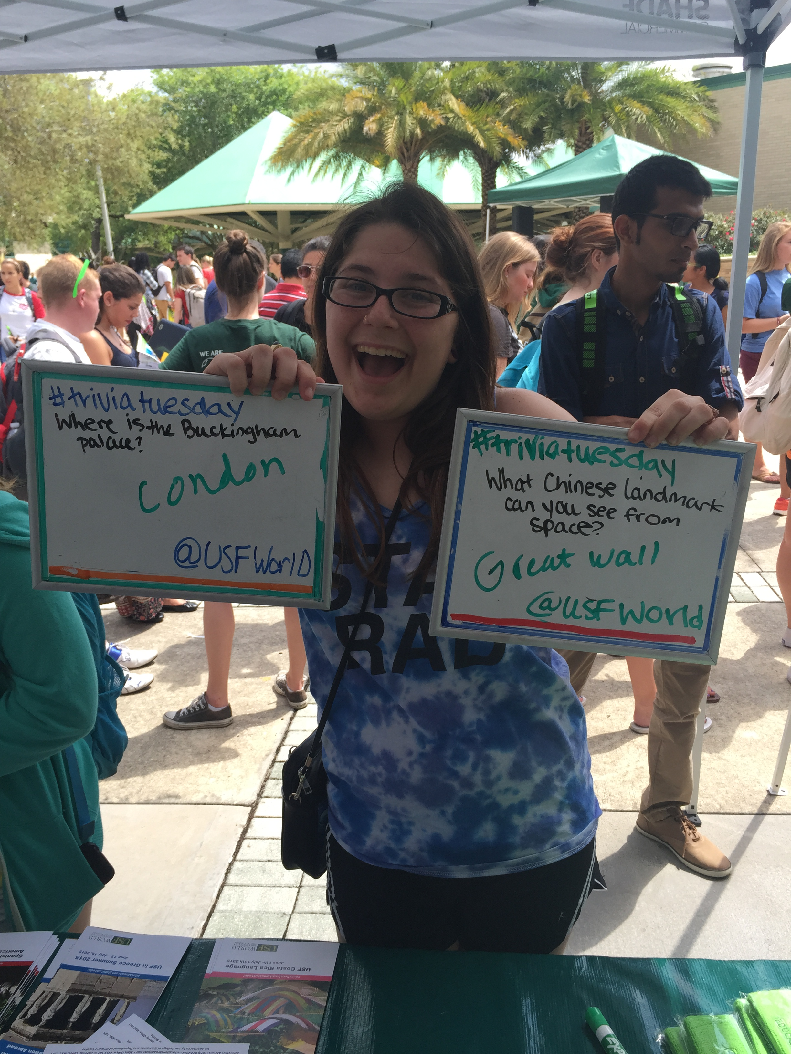
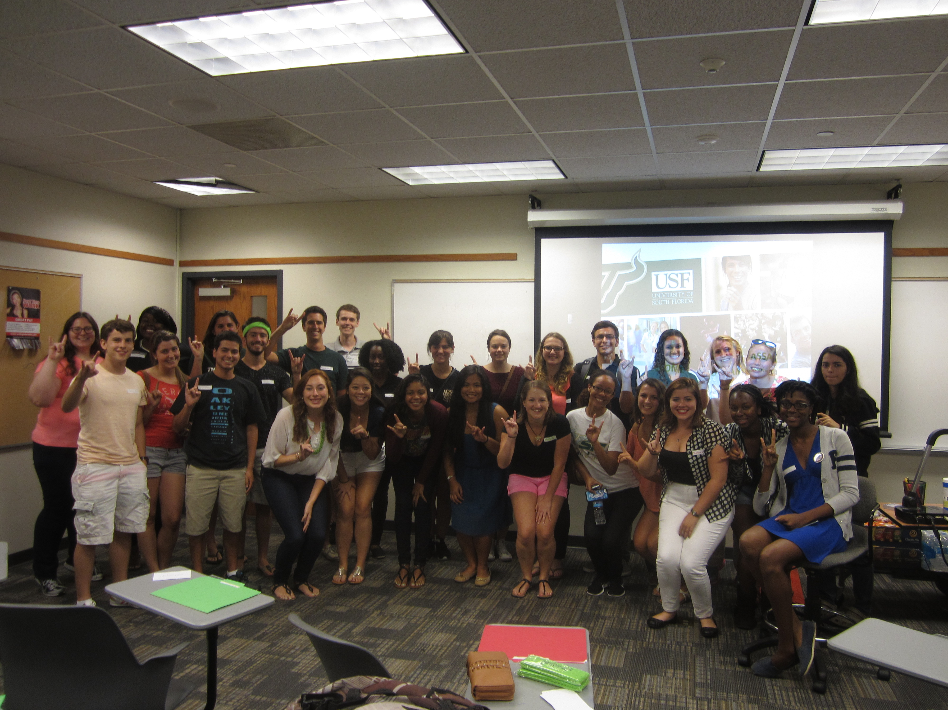
GloBull Ambassador Overview
GBA’s by the numbers
102 Applications for the Fall Semester: +100% increase from Fall 2014
36 returning GBA’s
**41% of students are now repeating the program**
74% completion rate (past 3 semesters)
Roughly 52 recruitment events scheduled per semester that count for GBA hours
1 social event per month specifically for GBA’s
Professional Development Session
Re-entry (Story Hour-Themed)
Fun (Bowling, Day at the Park, etc.)

Slide 10
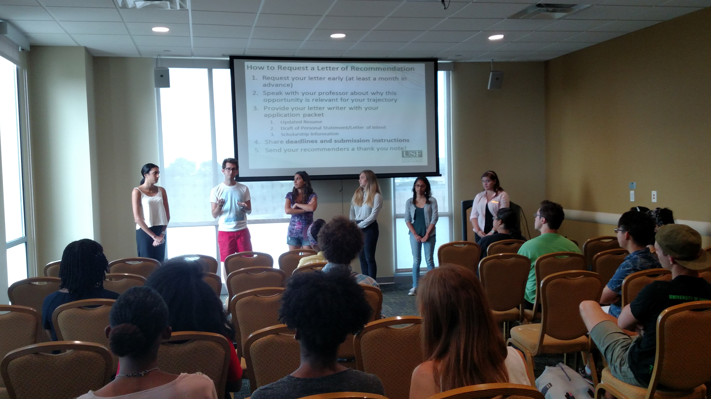
GloBull Ambassador Training
Training 101
Multiple training sessions early in the semester (mandatory for participation)
Bring the passion and challenge the students
*Be clear that this is a commitment but the impact can be substantial. Challenge the status quo.
Make connections early
*Students are the experts not you!
Fill students in on Office/University goals
*Different objectives are OK!
Food always helps
Example slides from USF training will be provided

Slide 11
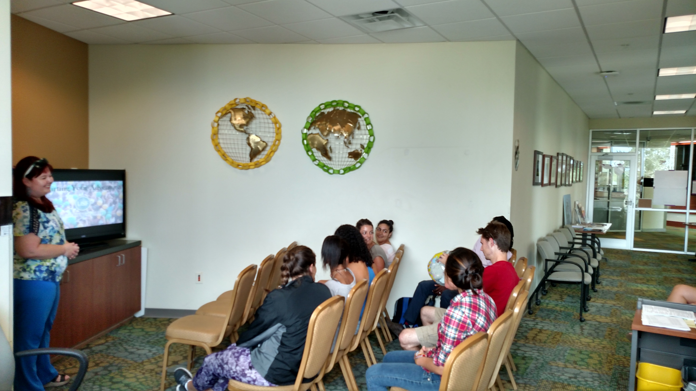
GloBull Ambassadors Goals
Program Goals & Objectives
Increase participation
  80% Completion Rate
  10 hours/GBA/semester
More opportunities for GBA’s
  Diversity Series
    Black & Abroad
    Men & Education Abroad
  One large event/month
  Digital Storytelling
    Paige Atchison
Re-Entry Focus
  Personal Development
  Professional Development
  Engage International Community on Campus
HAVE FUN!!!

Slide 12
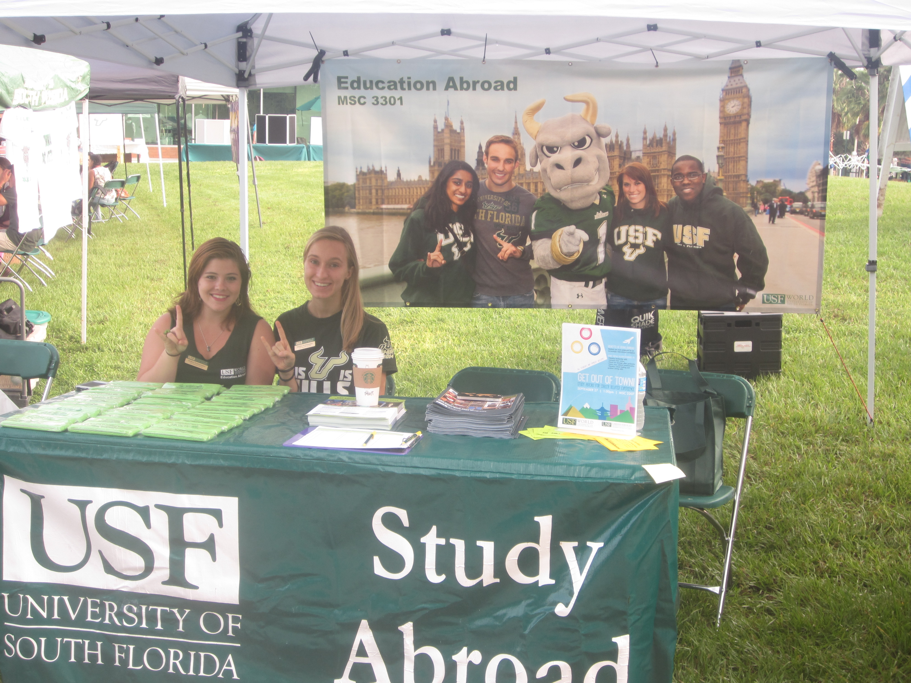
GloBull Ambassadors Goals
Program Goals & Objectives a Deeper Meaning for Students
Every story is important
Truly believe that you are making the world a better place.
Think about what our world would be like if the majority of students in college studied abroad.
Recruit the next wave of US ambassadors. Lets understand the other 96% of the world better.

Slide 13

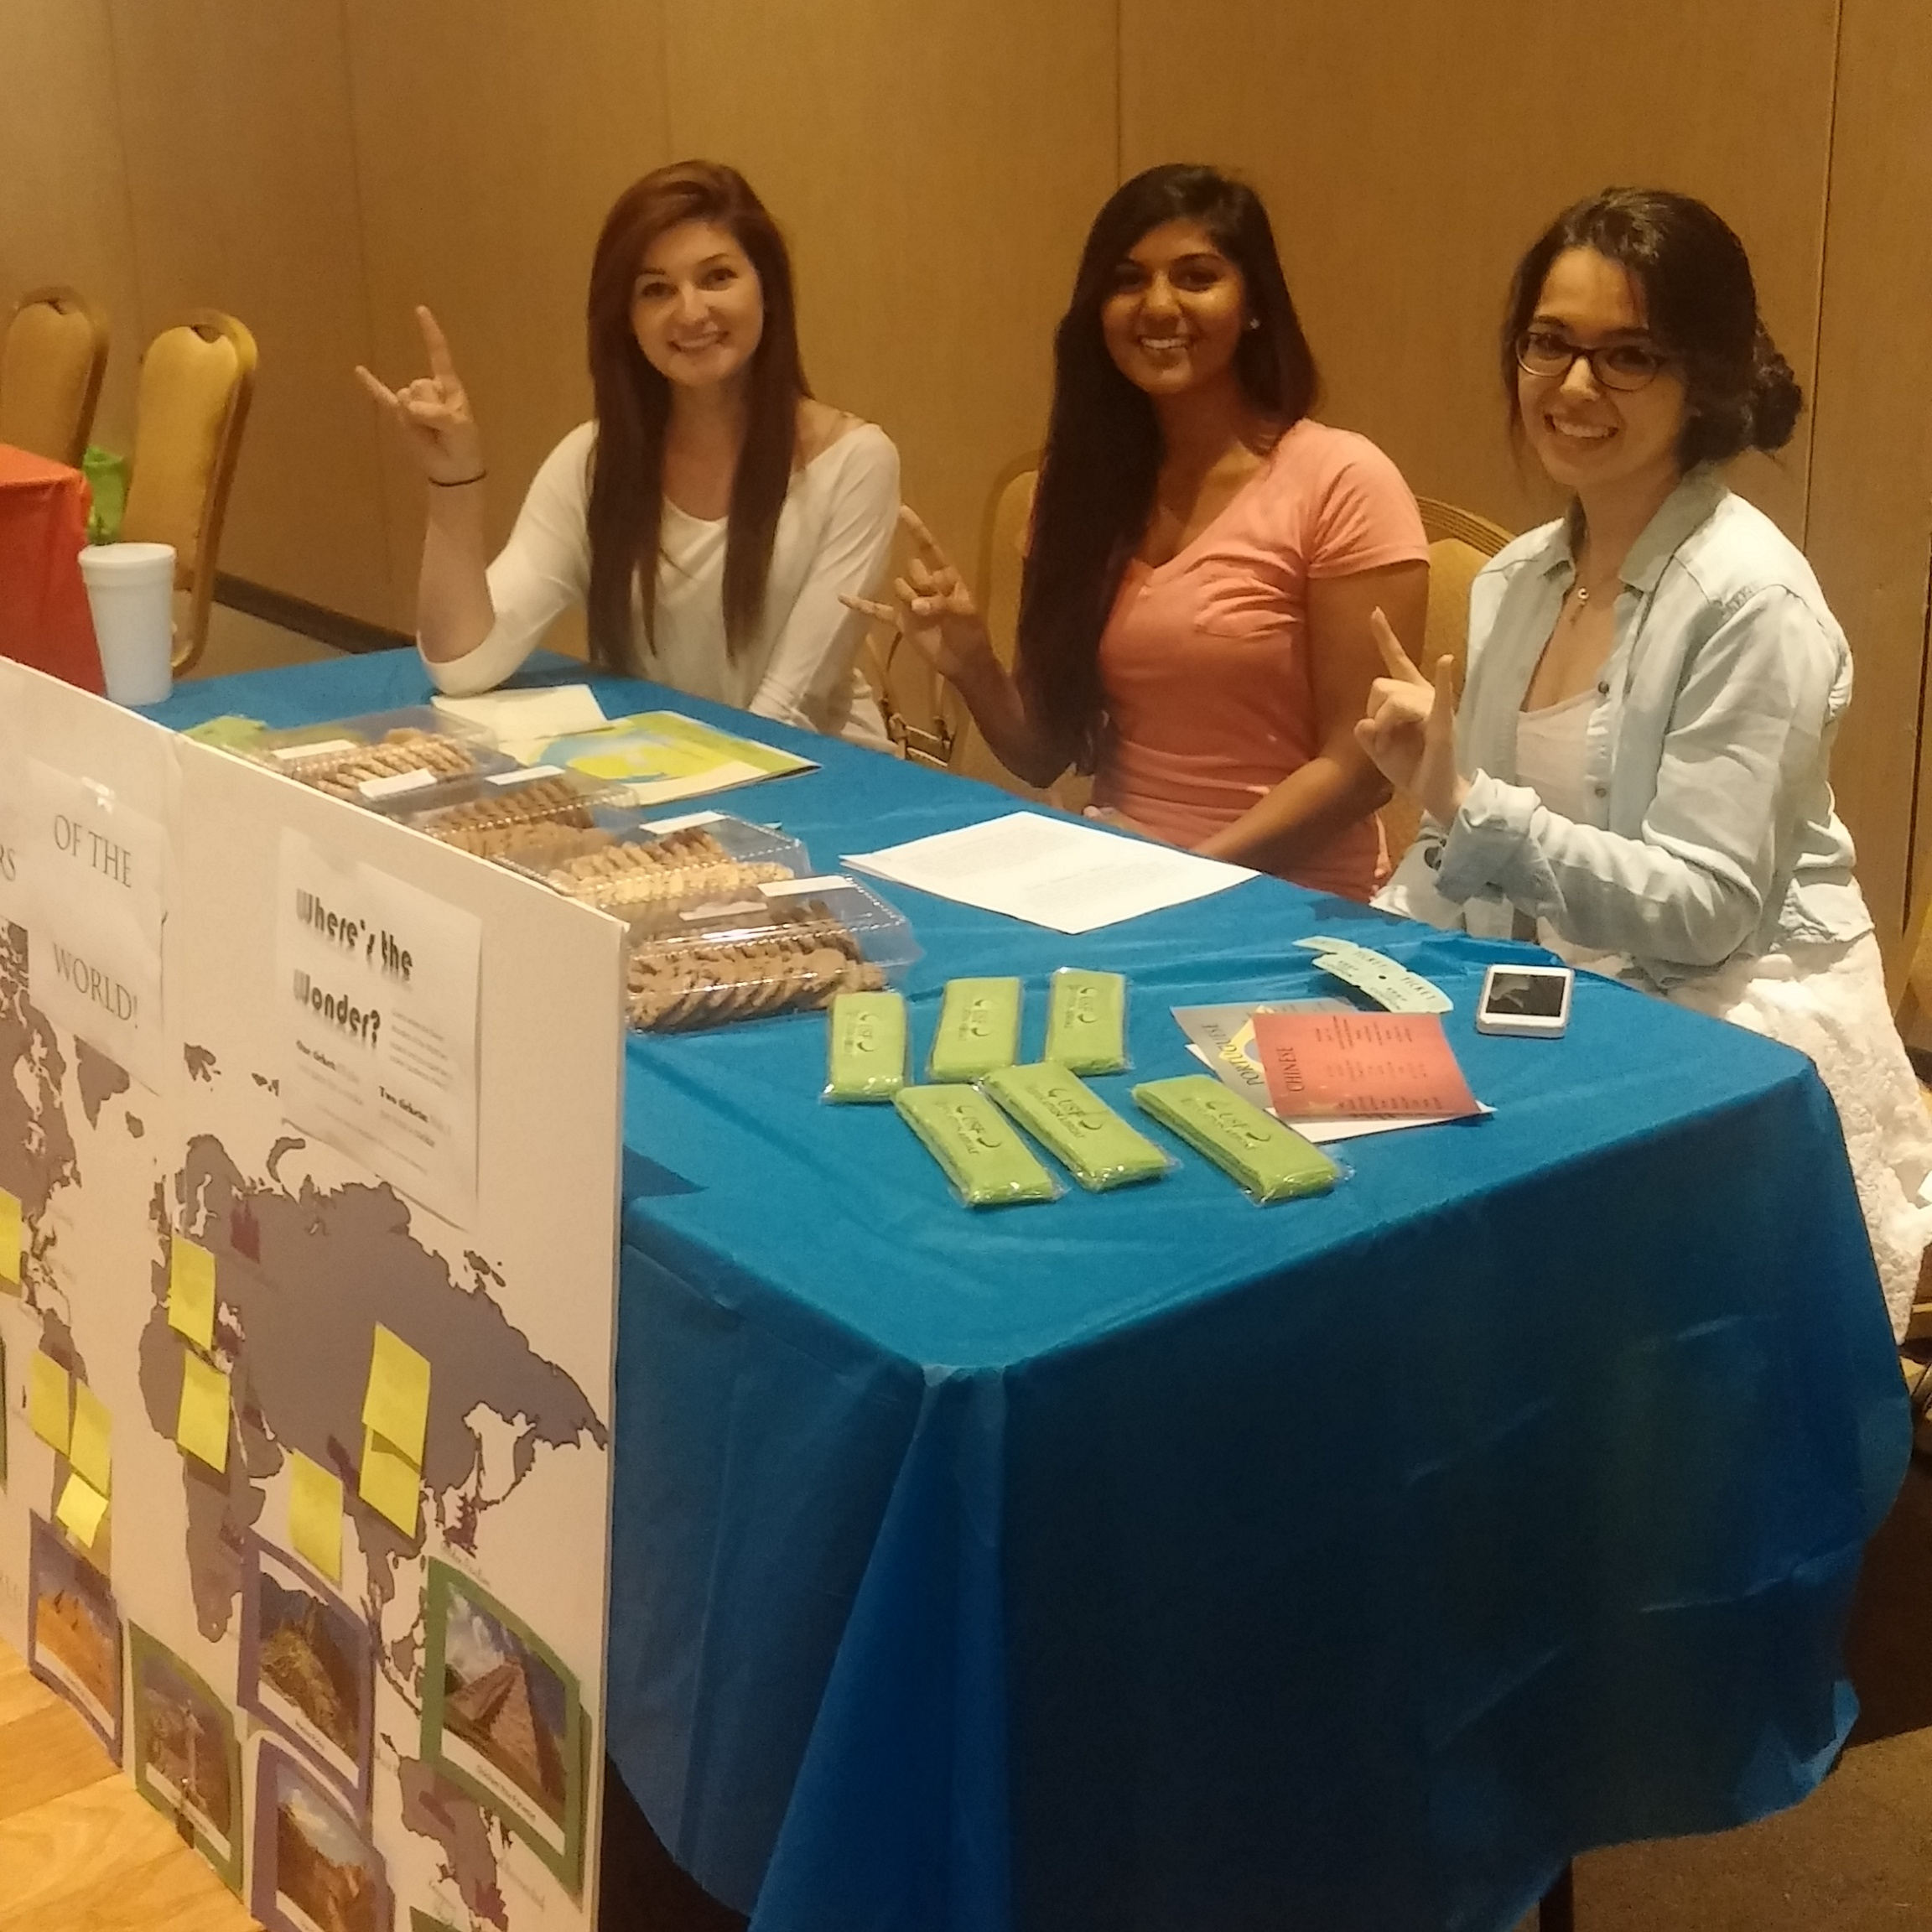
Creating Campus Partnerships through GBA’s
Things To Consider:
Connect GBA’s with advisors depending on location and programs.
Bridge campus gaps with GBA connections through student orgs and work placements. (i.e Career Services, Greek Life, Latin Dance Club, etc.)
Use established campus partnerships to connect ambassadors with resources to help with program development (i.e. Multicultural Affairs > Black & Abroad). Empower students to do the same.
Challenge students to go beyond when considering program development.
*Example: Men’s Night Out. How are we making this an inclusive program?
GBA social events ensure good attendance
*Career Services
Notes:
Creating campus partnerships should be no surprise, but allowing students to make these connections helps everyone involved.

Slide 14
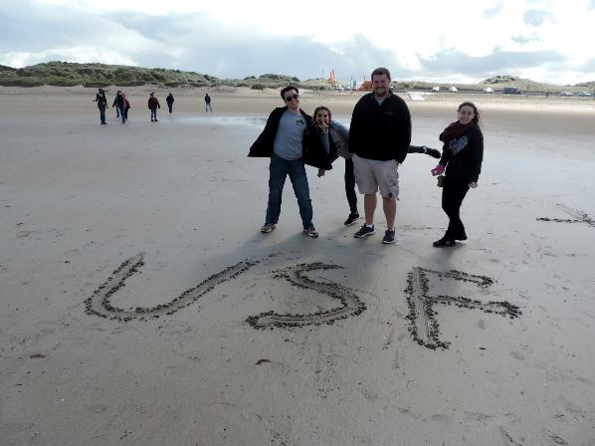


FACULTY-LED PROGRAM DEVELOPMENT
WORK WITH DEPARTMENT CHAIRS AND FACULTY
Look at Interdisciplinary Cross-Marketing
Connect GBA’s with new and existing faculty
*Our Study Abroad Advisors help with this.
Inform all Faculty and TAs about the Program and encourage GBA participation in presentations
Include Links to Program in Signature Line on Emails with GBA testimonials
Connect through our social media pages (Facebook/Instagram)
Notes:
This is our staple program model here at USF so we have a few suggestions to work more closely with program leaders

Slide 15

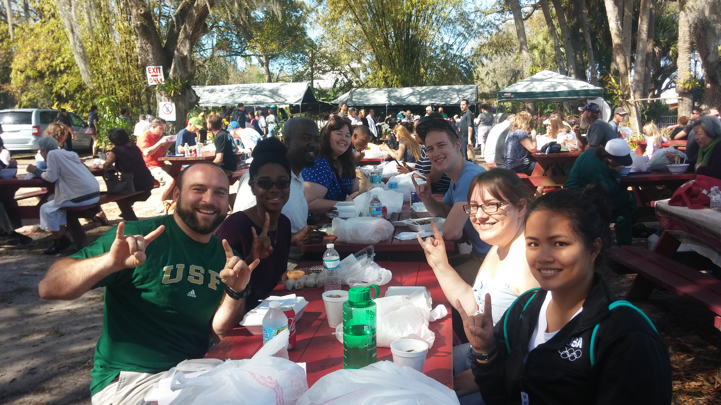
QEP-Combining Recruitment with Re-entry
Global Citizens Award
$2500 award for study abroad
Participation in a “Starting Your Adventure” Workshop
Attendance at 8 different on-campus global events
Two different pre-approved globally engaged activities:
• 90 contact hours of curricular or co-curricular community service
• 90 hours of undergraduate research
• 90 hours of internship
• Short-term USF-sponsored study abroad experience
• 6 credits of Global Citizens coursework
• 6 credit hours of foreign language study at the intermediate
level or higher
Reflection Essay integrating all selected experiences
GBA’s are the driving force behind such initiatives
Provides our students with international and reflective experiences on and off campus
Great opportunity for peer mentorship from start to finish
Notes:
Our GBA’s are typically the driving force behind these new campus wide initiatives. Making GBA’s invaluable to the success of such initiatives really provides legitimacy to the program.

Slide 16
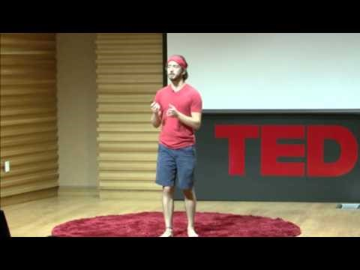
Combining Recruitment with Re-entry
More Examples:
Open social events up to ALL students
Seek out external opportunities for GBA’s
TedX, Sporting Events, Parent Weekend
Creating a PUBLIX experience at larger events
Helps peer mentoring
More personal reflection-every story is
important
Allow students to focus on what they are
passionate about:
Diversity Series
Scholarships (Youtube-In Your Shoes)
Digital Stories
Be open to ideas

Slide 17
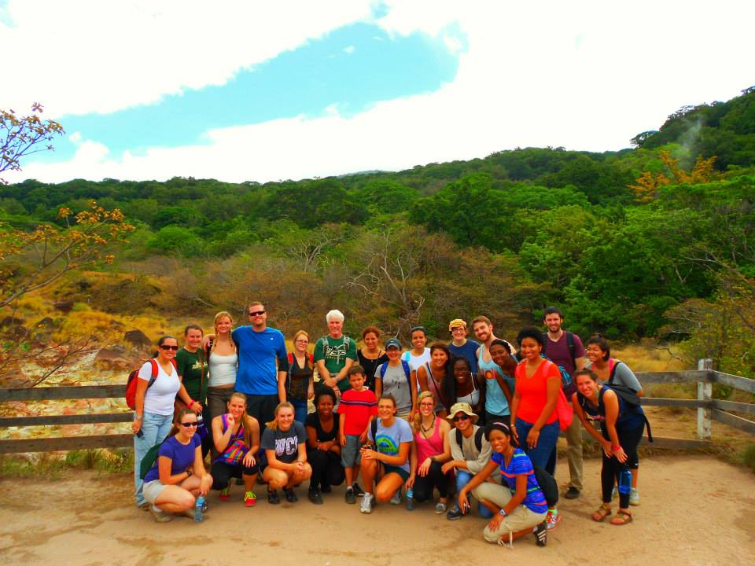
GloBull Ambassador- Tanisha Pierrette
Senior
Criminology & International Studies Major
Studied abroad in Costa Rica with about 25 students
Her story:
Notes:
So here’s my story, I studied abroad in Costa Rica with about 25 students and when I returned home I was showing my sister pictures and she said wow, there was a lot of black people on your trip. I made a quick count, there was 4 of us. For some old reason that comment stuck in my mind. Then I became a GBA and I realized minorities, specifically black students were not taking an interest in studying abroad and that blows my mind, because who wouldn’t want to study abroad.
So my first idea was to just tell all my black friends why they should study abroad, all the amazing benefits and how it’ll make you stand out to future employers. But that could only go so far. And then I started thinking what if The Education Abroad Office had an event. Before I pitched my idea, I wanted to be credible and I wanted to be taken seriously so I spent a few days researching who was studying abroad, I started asking people what’s keeping them specifically from studying abroad. If I knew that why I could slash out that excuse before it was mentioned.
My intentions were to walk into Chris’s office, pitch my idea and walk away. Chris on the other hand liked the idea so much that he gave me the responsibility to create and develop this event with his support of course. He had a very positive reaction to my idea and his excitement made me even more excited.
This model may not work for everyone, not all students have experience in developing and planning events. To be honest I had never done anything like that, I’ve helped plan events but I’ve never lead one. It would be best to be more hand on with other students when but because I was now personal connection with it I was not going to let it fail.

Slide 18

Black & Abroad
What made Black & Abroad Successful?
Having a diverse panel that lead to open discussion
Having advisor to answer specific programming questions
Having statistics available
Having food
Not tiptoeing around race, being open and honest that race is a factor
.

Slide 19
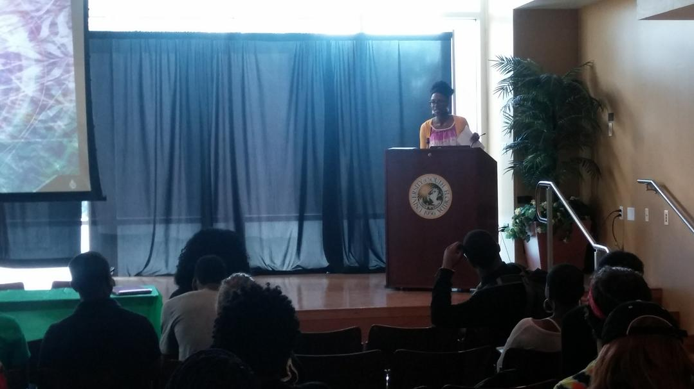
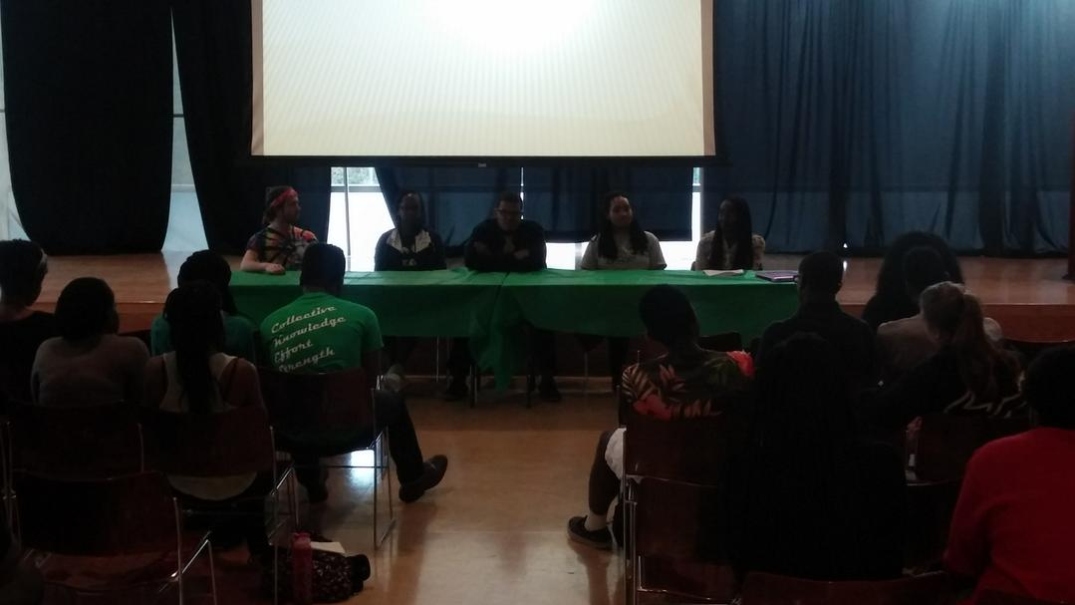
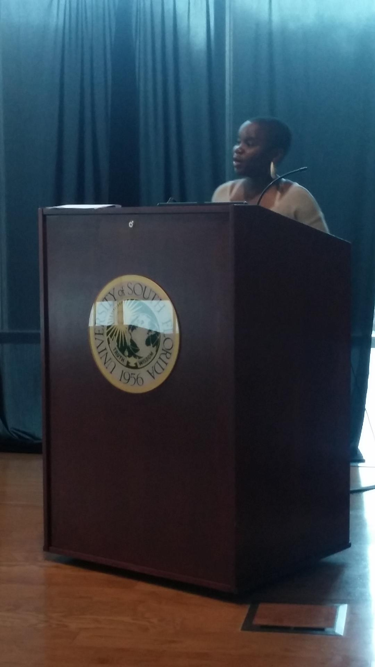
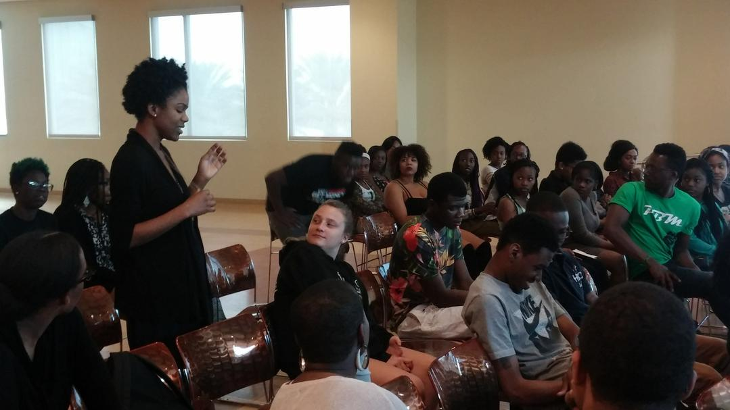
Black & Abroad
Result?
What do the numbers say?
National Average vs USF Average
We had 38 attendees
4 student studied in Spain the following summer

Slide 20

What’s Next for Black & Abroad?
New Panel with brand new locations
Teaming up with Office of Multicultural Affairs, they can expand our reach on campus, I'm reaching out to the National Pan Hellenic Council, The Department of Africana Studies
I'm taking advantage of the committees and delegating task , for both ideas and action

Slide 21

Student Led Programming-Tanisha Pierrette
What makes student lead programing successful?
First and foremost, having support from the education abroad office has to be immense.
  Chris from the Education Abroad Office made it clear that he wanted to hear our ideas on how to improve the program. He never just handed us assignments and told us to do it but he would engage us and ask questions.
In order for student lead to be successful, student must feel that their ideas matter and are taken into consideration.
  If students see an area that lacking and you encourage them and allow them to be creative and take lead, it gives them the tools to develop a great event
When Students are responsible for an event, they now have a personal stack in it, they will put more work into it, and they’ll advertise fort it without being asked. The event becomes an extension of them and they will not want to see it fail.
In comparison to other events that exist, all they typically have to do is show up and talk about their experience and answer questions, that can get a bit boring and repetitive, which can lead to a lack of motivation.
Having a team of other committed students to execute the event.

Slide 22
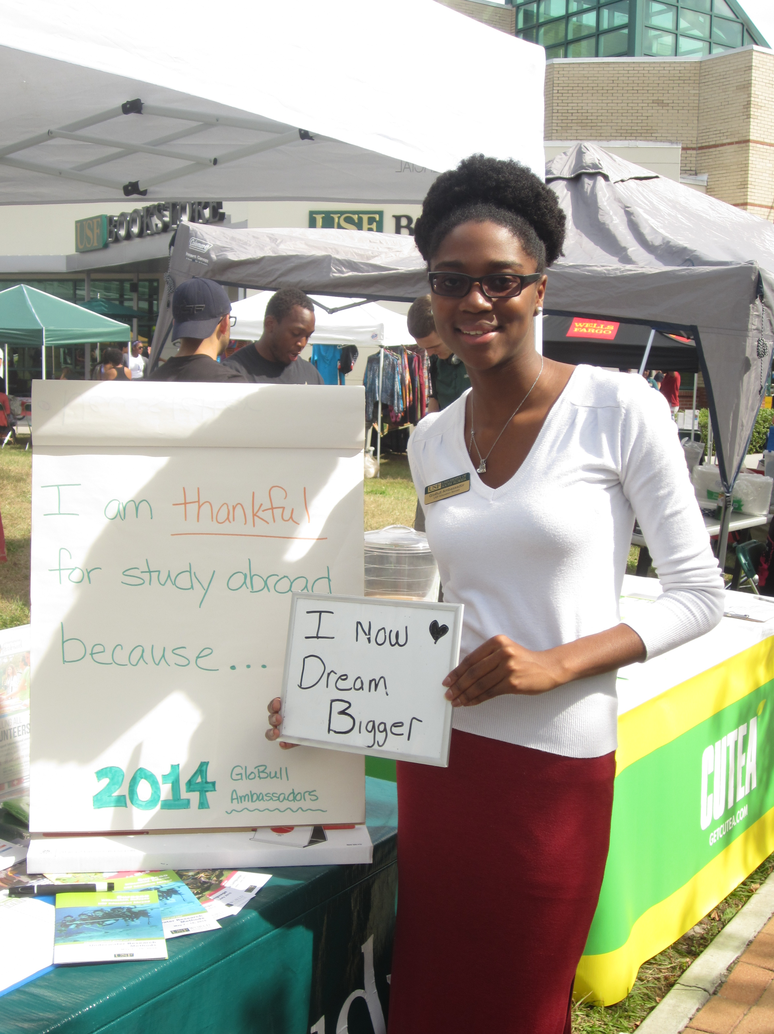
Closing

Slide 23
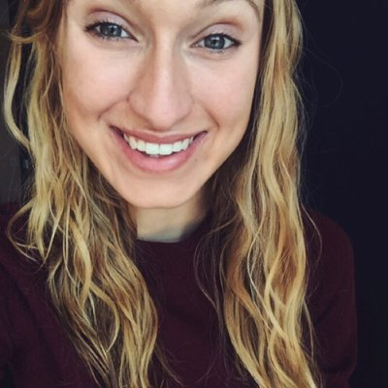
GloBull Ambassador- Lia Fleming
Senior
Health Science Major
Studied abroad in Florence, Italy
President of the GloBull Ambassadors
Her story:
Notes:
One of my favorite questions to ask students who’ve studied abroad is to ask, “What made you decide to study abroad?”. I ask this question because every student has different factors that influenced them to study abroad, and these questions are important to ask in order to find out which factors draw students into study abroad.
During my freshman year orientation, my mom attended an education abroad event. She came back with an armload of various pamphlets for education abroad- I was furious. “Mom, I am so overwhelmed with college, how dare you put this on me!”
I ended up thanking her later when at a less stressful time; I came across those pamphlets and ended up signing up for our USF in Florence trip, held over the summer. I studied various topics such as intimate relationships, water coloring, and comparative political cultures. I got out of my comfort zone; I made everlasting friendships, got to know a new culture, and even got to know myself better. It was the most dynamic and best six weeks of my life. I don’t have to sit here and tell you how great education abroad was because chances are if you are in this room, you already know.
I came back to the US, got my chipotle, hugged my dog and then…. Nothing. I suddenly was dumped back into my old lifestyle that I was no longer equipped for. I had no way to digest my experience or figure out where to go from here.
Enter GloBull Ambassadors, a program run by USF World. GloBull Ambassadors is a medium for students who have studied abroad to outreach to other students and initiate a conversation about study abroad. At the time, Chris was just taking over the program and developing it to where it is today. I figured this would be a good way to get re-involved with the process, so I joined. I was thrilled that GloBull Ambassadors gave me a platform to encourage other students to take their education to new heights. Since joining fall of 2014, I have participated in a variety of events ranging from Bull Markets, to events catering to new students, as well as participating in socials and events with our international community.
However, there seemed to be something missing within the core of the program. As students, we knew what it would take to reach out to new students to start the conversation about study abroad through our traditional events, however we lacked the structure and resources to execute our plans for improvement. We also wanted to work on re-entry and translating our experience here professionally, academically, and personally. As a result, an executive board was created to provide leadership and structure to our program. I now serve as the first president of GloBull Ambassadors. I will now go over some of the benefits to why we think this structure will assist with both outreach and re-entry efforts. Granted, this executive board has only been in place since the end of the summer term, but I hope to highlight why we think this structure will help us reach our future goals.

Slide 24
GloBull Ambassador Program Development
Program Structure
Our GloBull Ambassador Executive Board consists of:
President
Vice President
Director of Marketing
Secretary
We also have Advisory Subcommittees that work on certain initiatives determined by GloBull Ambassadors & Student Program Coordinator:
Scholarship
Program Development
On Campus Marketing & Outreach
Member Engagement
Notes:
1) Go over structure. What is it? How does it function? What was the application process?
2) Our goal is sustainability. We want something that is student built, student ran, is still going strong in 5 years. We want to build off each other's previous work, not start completely over with each batch of new students. Our main focus this year is to provide that structure so that 5 years down the road, GloBull Ambassadors is still student-run, and is building off the previous work of earlier semesters. By next year, the structure will be built and they can work on the functioning of the program, including outreach and re-entry.

Slide 25
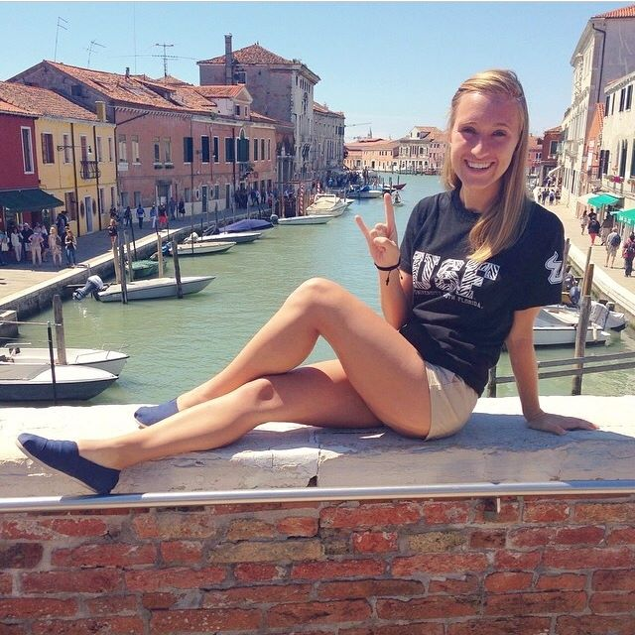
GBA Structure Magnified
Executive Roles
We believe that these are vital roles that strengthen our program as a whole. Some aspects include:
President
More involvement with other organizations on campus
  These connections will get GloBull Ambassadors to reach out to “other” parts of campus
New initiatives as reflected by the needs of both our GloBull Ambassadors and our students on campus
  Focused on new initiatives to underrepresented groups in study abroad
Provide support for GloBull Ambassadors and also act as a medium to help them gather the resources they need to accomplish their goals
Keep new members involved, as a mentor role
Notes:
As president, I need to know our program. I need to know how it works, I need to know our members, including their strengths. In order to do that, I need to be present and get to know our members. By getting to know our ambassadors, I can direct our outreach efforts towards those target areas. For example, I had a conversation with one of our male ambassadors on how little male participation we had in our programs, and why that was. From there, we were able to start to build outreach programs to tackle those problems, driven by those students who are passionate about these topics. The president's role also includes outreaching to other organization's on campus. For example, I've been working with the president of Latin Dance Club and separately the president of International Student Association. I offer support in the running of their programs and provide GloBull Ambassadors to assist with their programs. This increases our outreach to other parts of campus by getting our name and reputation out there. By establishing meaningful connections, we can get to know the needs of our campus and translate that to more outreach efforts.
Besides outreach initiatives, I have worked to create more cohesion within the group. As ___ members who have studied abroad, we are a student body that can support each other during re-entry efforts, and I intend to create mediums which meaningful conversation about education abroad can be fostered. For example, we had a bowling social two days ago for the students to get to know each other. In October, we will have a "Fall Coffee Shop" where guided discussions will allow members to digest their experiences. In November, we are teaming up with career services to talk about how to translate those experiences to tangible skills to be used in the work place, including how to integrate study abroad in a resume or cover letter. These re-entry initiatives will assist in defusing reverse culture shock and translating educational experiences into productive means.
Finally, its important for the president to understand the roles of other executive board members and our subcommittees in order to assist in facilitating activity within our programs. Right now, the executive program and I are working to establish a constitution for our program to provide structure for years to come.

Slide 26
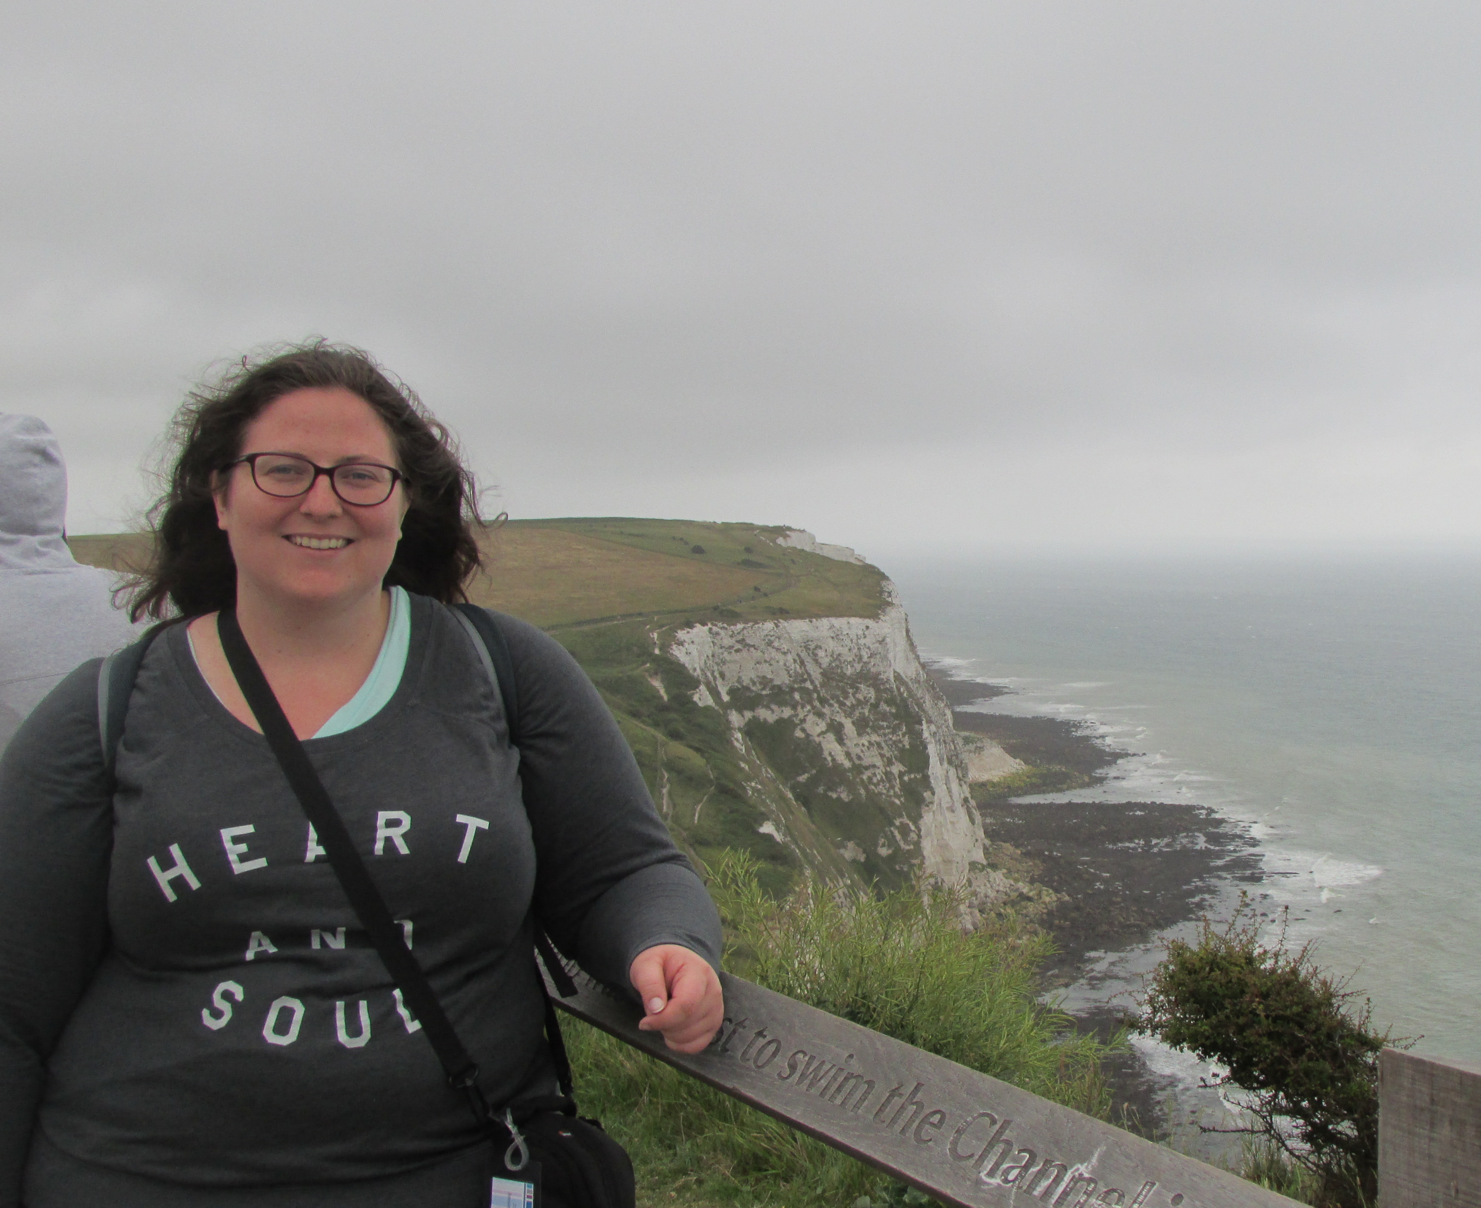
GBA Structure Magnified
Executive Roles
Vice President-Caitlin Pike
Works on improving and developing the programs that GloBull Ambassadors run
Manages sub-committees and oversees their tasks and initiatives
Organizes the page that GloBull Ambassadors can sign up for event
Notes:
The vice president works on infrastructure and makes sure thing run smoothy within the program, and handles a lot of trouble-shooting within the program. Right now, our VP is working on finding the best medium to track things like hours and how to best communicate information to our members. One of the biggest components of her job is to manage our subcommittees and provide them the support they need to carry out their own goals and initiatives.

Slide 27
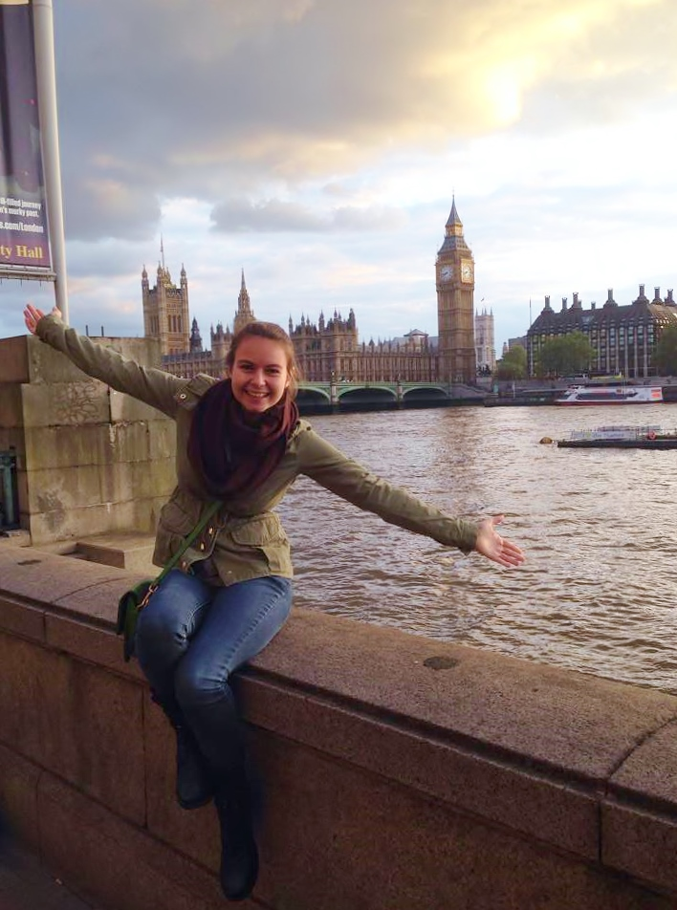
GBA Structure Magnified
Executive Roles
Director of Marketing – Kathryn Raines
Markets our events to our student base at USF
Markets our events within the GloBull Ambassador community
Creates a brand for the Ambassadors
Markets to underrepresented groups in study abroad
  This requires cooperation with other student orgs, committees and GBA’s
Most popular subcommittee
Notes:
The director of marketing works with both in-bound marketing to our members as well as the out-bound marketing to our general student body at USF. She is working with a close-knit subcommittee that works on social media, flyers, chalking, or any means to outreach to students. Our current Director of Marketing, Kathryn Raines, is currently researching the most effective techniques to advertise.

Slide 28
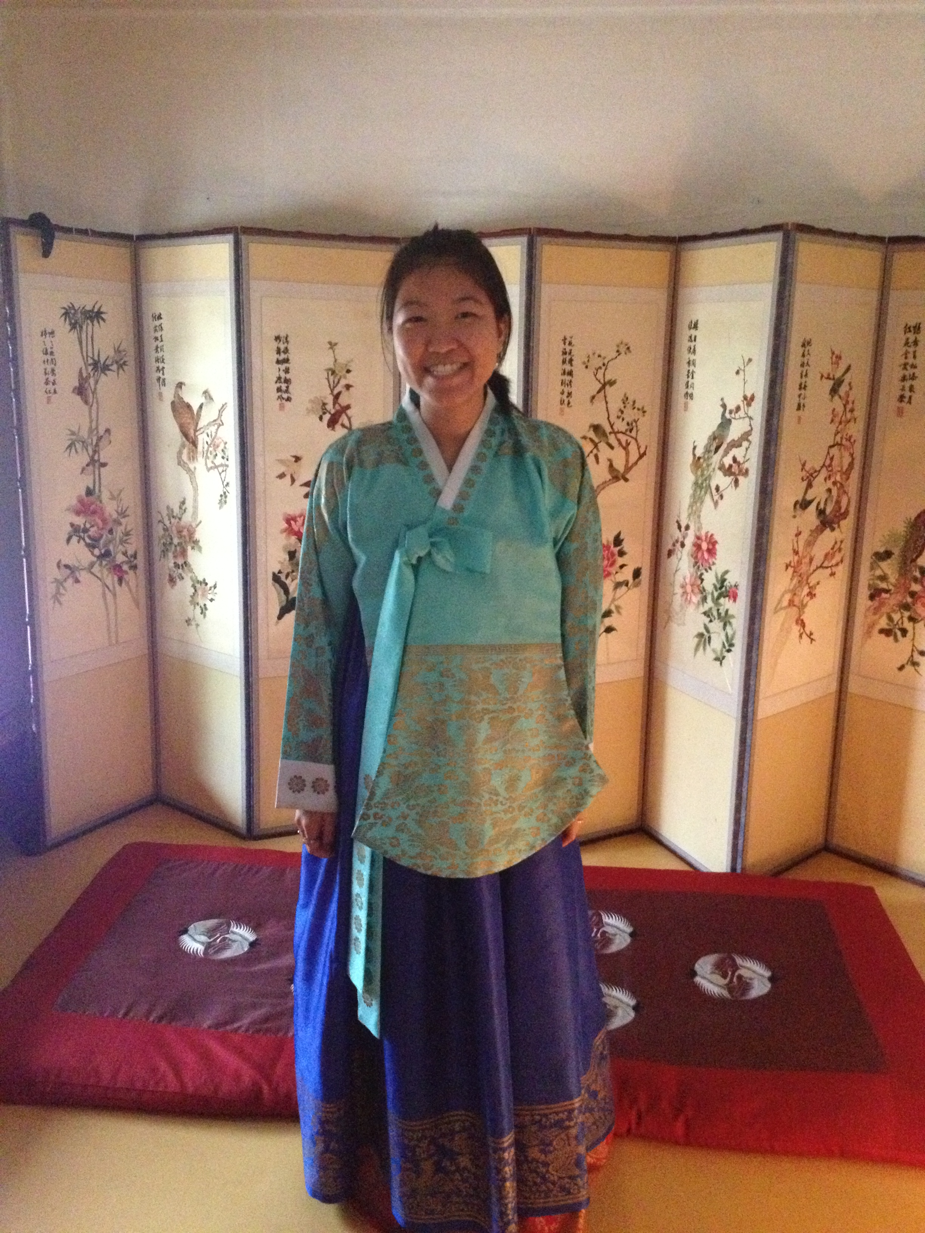
GBA Structure Magnified
Executive Roles
Secretary-Hanna Ro
Keeps track of hours completed by GloBull Ambassadors
Enhances communication between Ambassadors
Tracks progress and goals of Ambassadors
Notes:
Our secretary is one of the key players within the sustainability of our program. Currently, she is spearheading the folder-plan, in which every executive board member creates a folder of responsibilities, how-tos, and progress during office. She also tracks hours of our members, decisions made in executive meetings and committee meetings, and communicates those decisions to appropriate parties. All of these items will be passed on to future Executive boards and committees to provide guidance and support during their own endeavors.

Slide 29
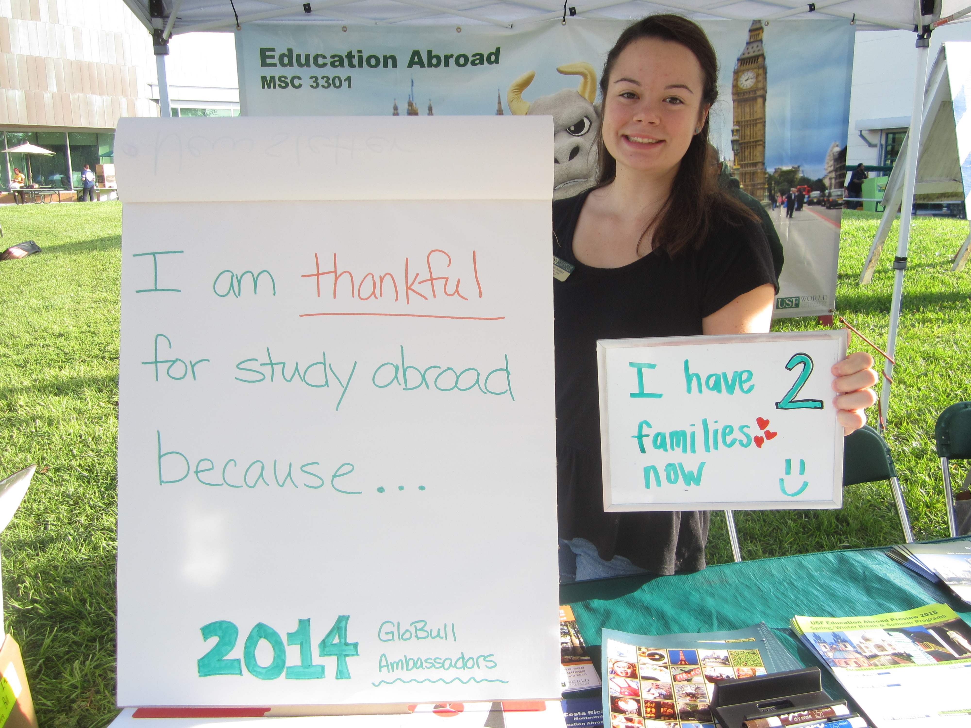
GloBull Impact
What are some of the benefits of student leadership?
Some of the benefits of student leadership include:
Effective execution and structure to design events for outreach
Student-to-student re-entry efforts
Student-fueled initiatives for outreach
Students know what students need and we are passionate about peer mentorship.
Notes:
Some of the benefits of student leadership include more defined roles. By defining roles, it creates a more effective system for executing and designing events for outreach. It also creates structure within our community to assist with re-entry and digestion of our experiences abroad. By implementing leadership, systematics can be defined and sustained year to year, while improving and innovating for a bigger study abroad community.

Slide 30
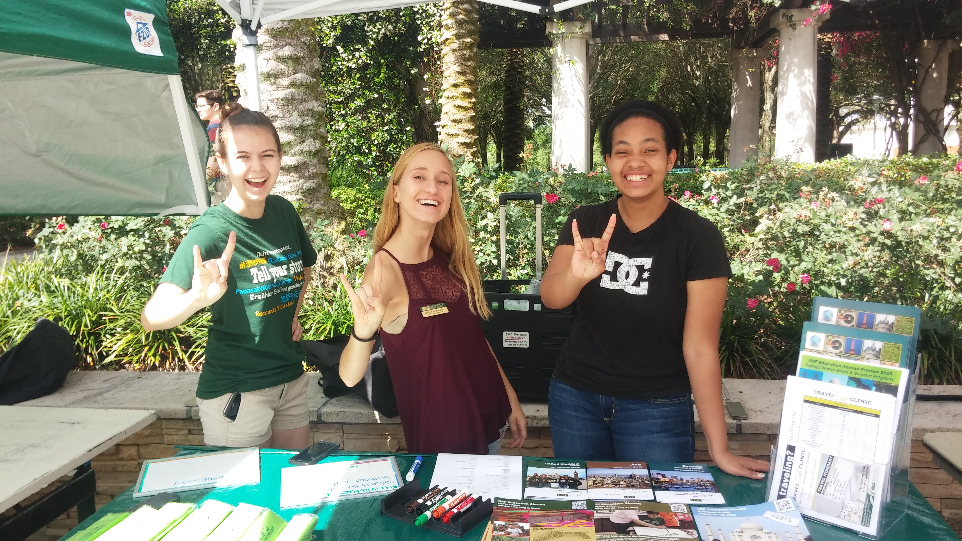
GloBull Impact
How does student leadership help with re-entry?
Student designed events catered to providing community support for re-entry
Executive board support through office hours
Students who have gone through re-entry can mentor those who are currently going through it
Notes:
​By creating a structure of leadership, we are able to promote a community in which promotes reflection of our experiences abroad. The executive board holds office hours in which students can engage and discuss re-entry as well as working to design events catering to the re-entry process (i.e. resume session with career services to discuss how to put study abroad on a resume). Students who have gone through re-entry are best suited to assist those through re-entry, in turn creating a more effective re-entry process.

Slide 31
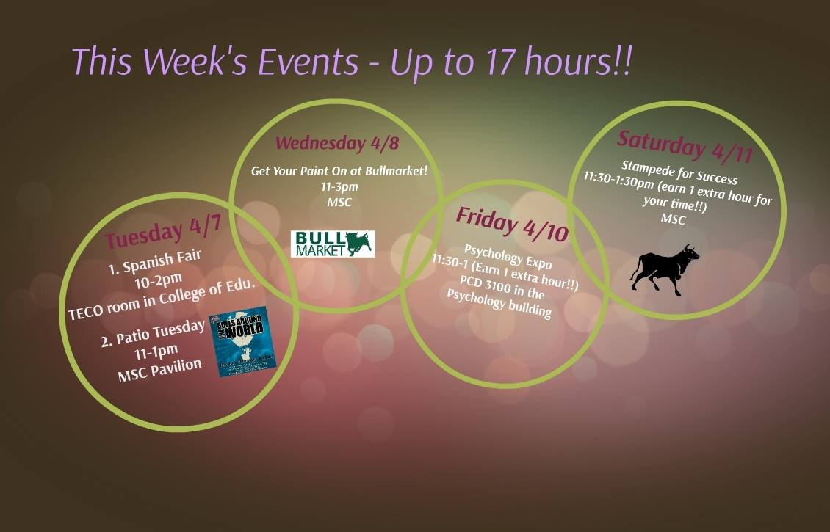
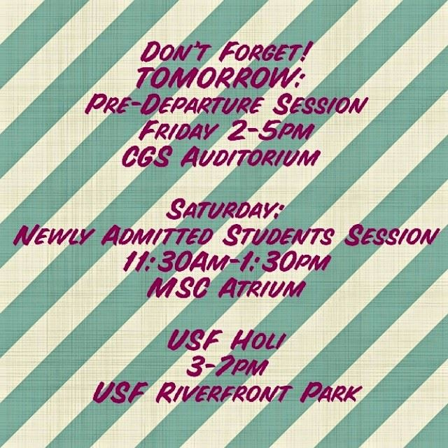
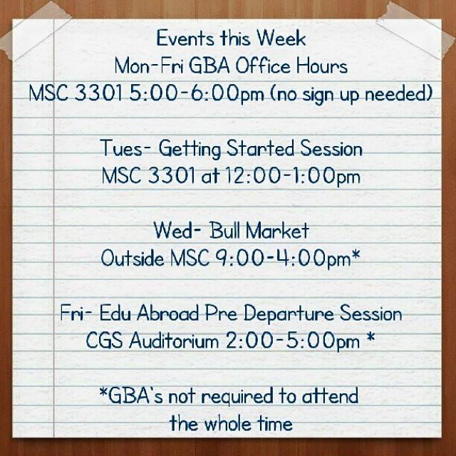
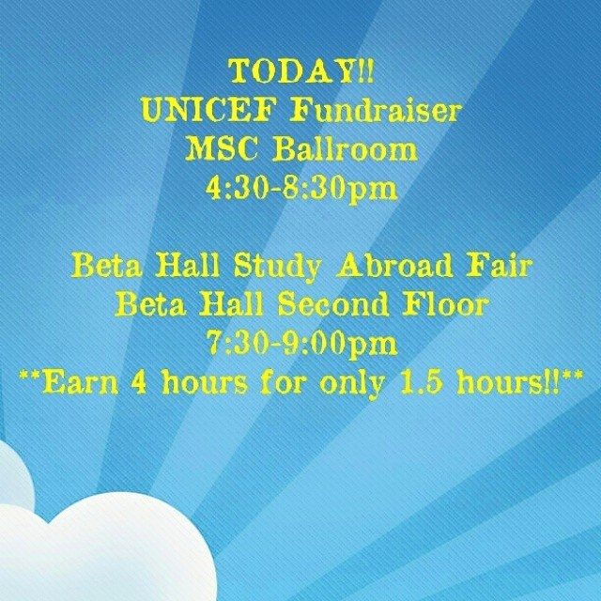
GloBull Impact
How does this affect our outreach dynamic?
We know and understand effective marketing techniques because we have been the audience for marketing in college
We can cater to the needs of our student body
We can identify and invest in the passion of our GloBull Ambassadors
Notes:
Students are more aware of effective strategies for marketing and the study abroad process because we have experienced it first-hand, so we can design and execute outreach with peer-mentorship in mind. By implementing leadership, it allows the program to cater to the needs of our student body, while investing in the passion of our GloBull Ambassadors.

Slide 32
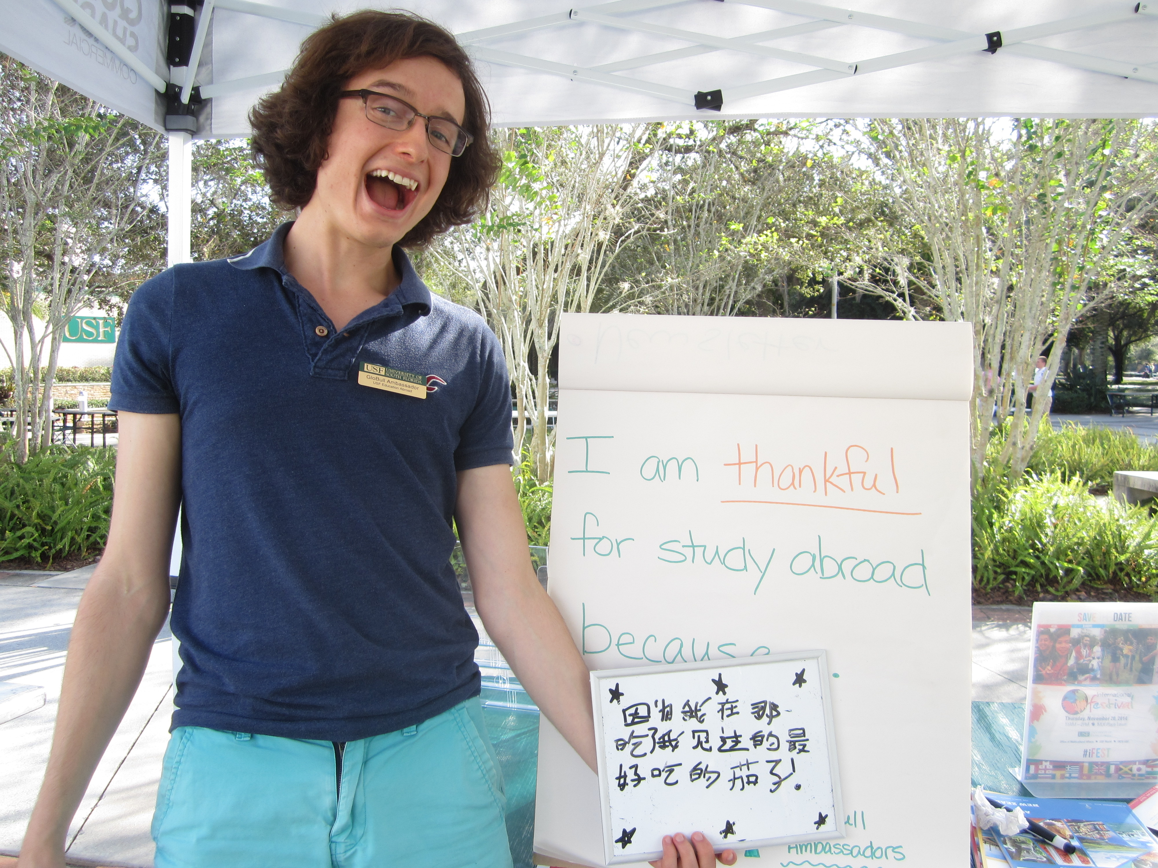
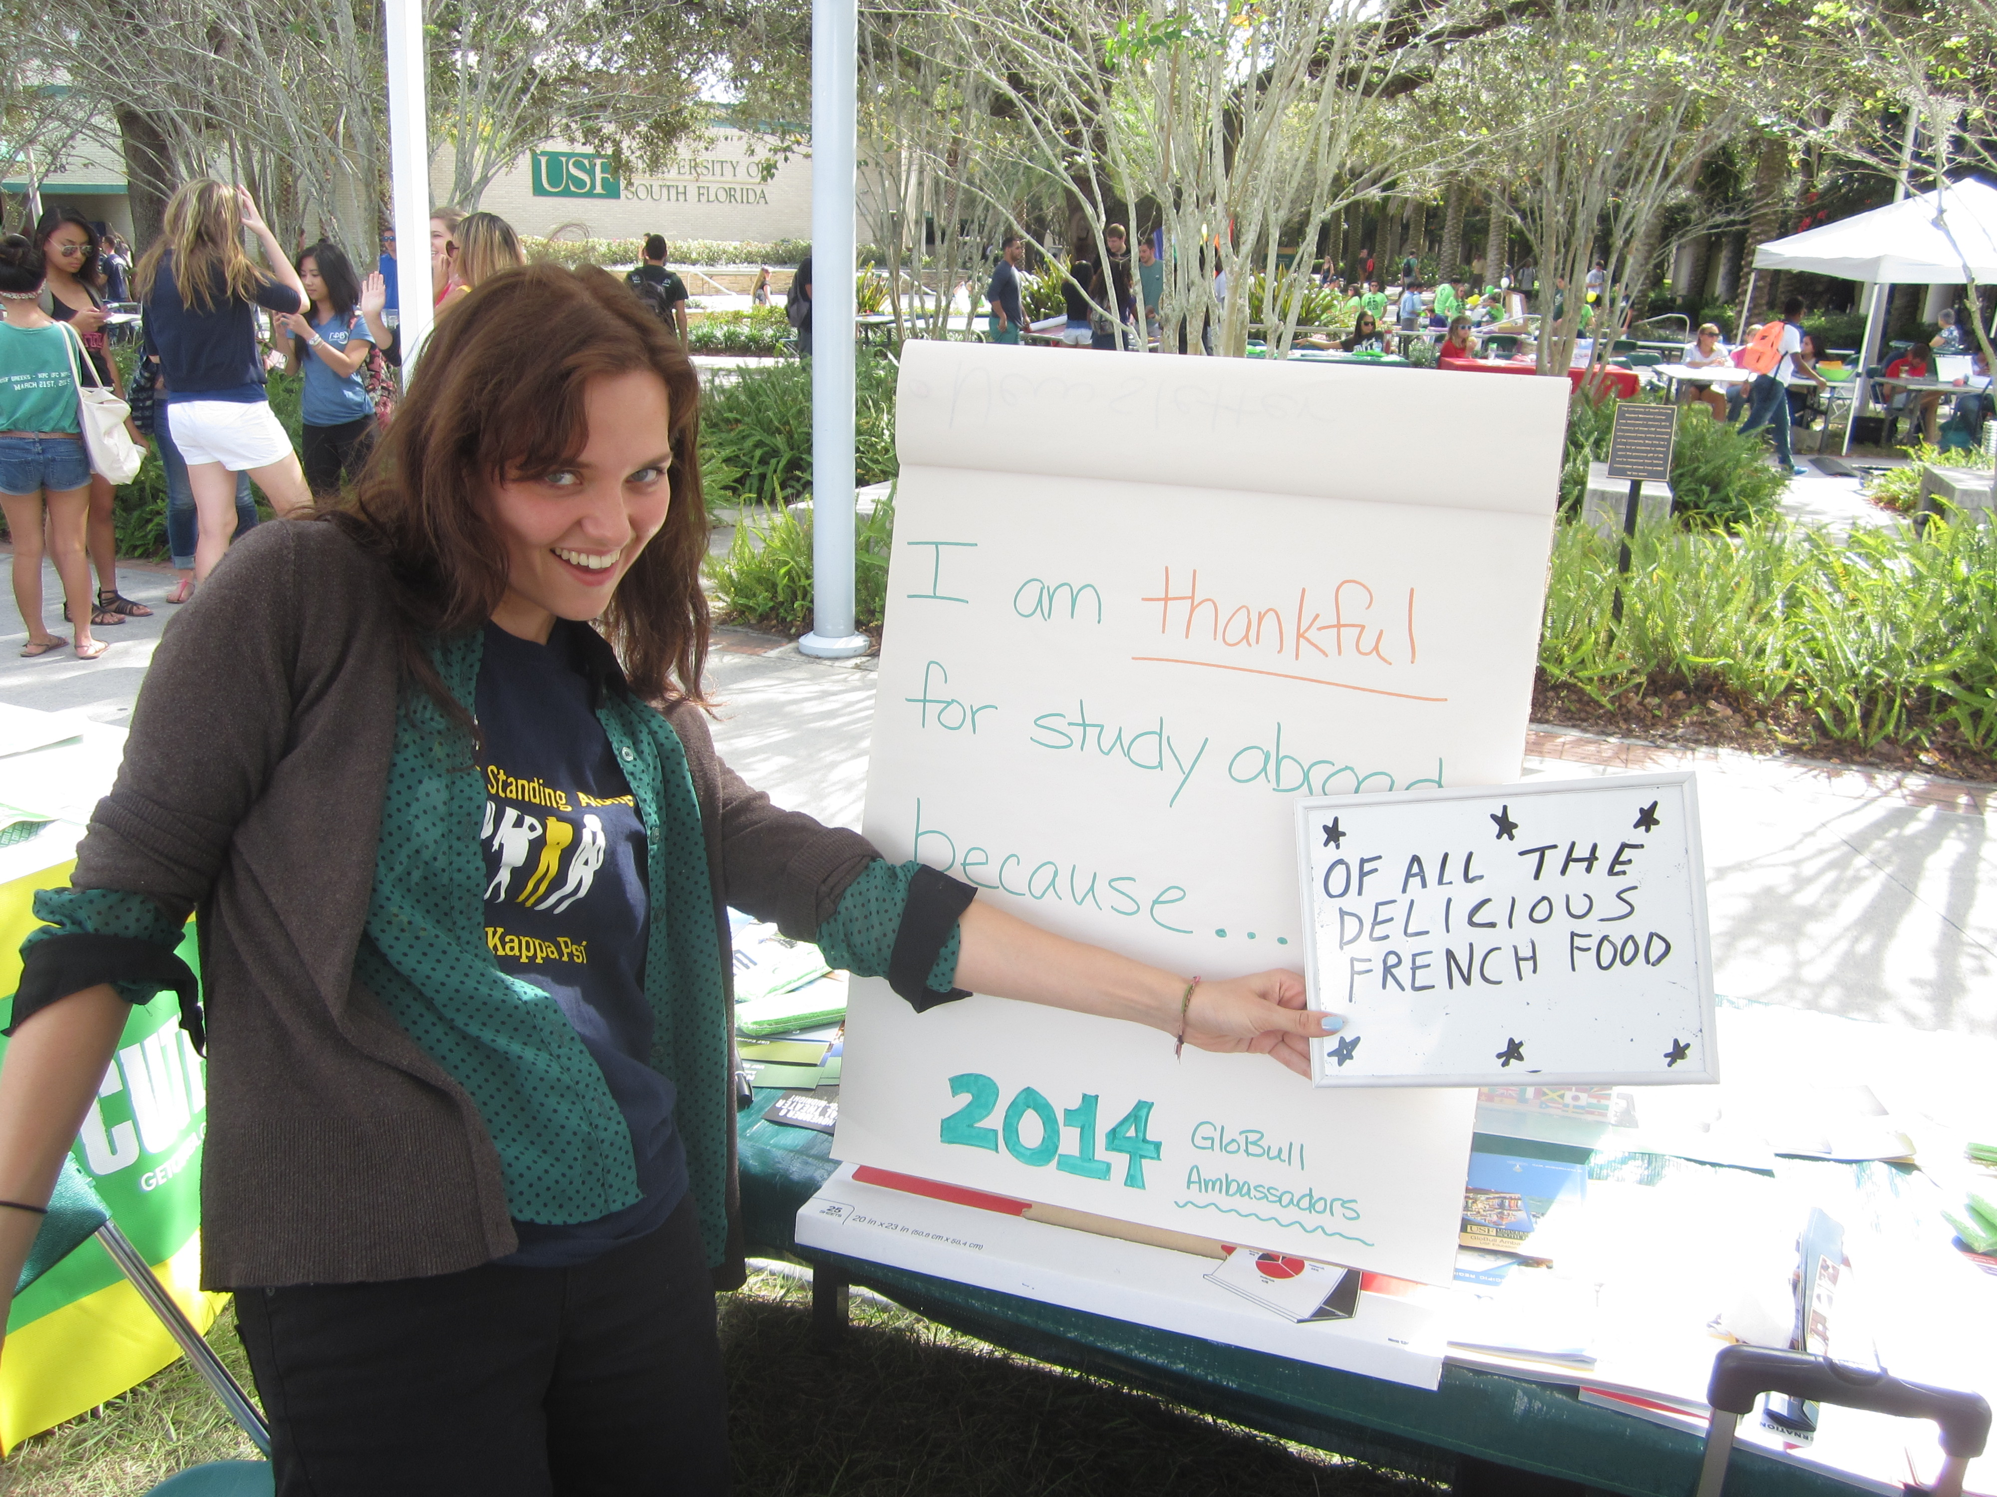
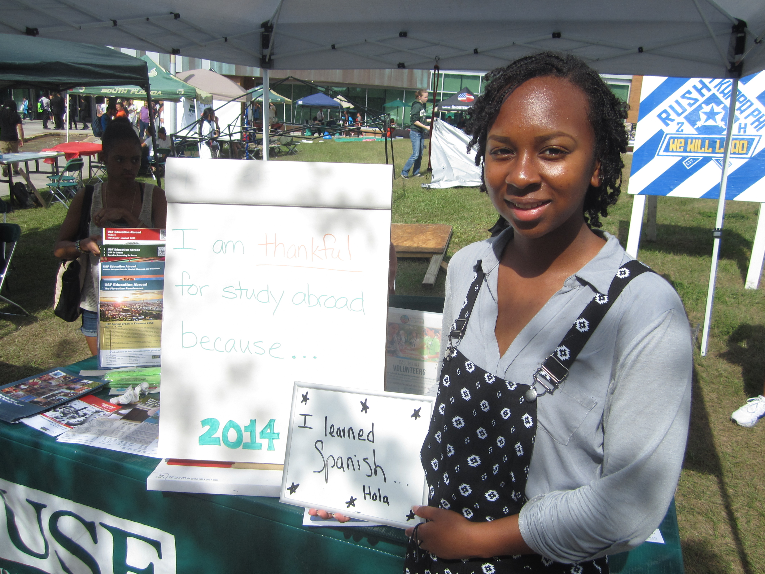
GloBull Impact
What does the future look like for GBA’s at USF?
To create a sustainable and self-sufficient ambassador program that is integrated to our student body needs. We plan to have a heavy focus on re-entry program, which will assist with our outreach efforts through reflection.
Insert student mock 5 year plan

Slide 33

OPEN DISCUSSION
THANK YOU FOR YOUR PARTICIPATION

